Slide 1
Notes:
Congratulations on your upcoming graduation!
This presentation will outline what lies ahead as you begin a rewarding career in dental hygiene. To help you prepare, you will require support and access to resources. This is where CDHA can help!

Slide 2
Our Mission
CDHA: Your National Association
CDHA exists so that its members are able to provide quality preventive and therapeutic oral health care as well as health promotion for the Canadian public.
Notes:
CDHA is the collective, national voice of more than 28,495 dental hygienists working in Canada, and we directly represent more than 19,000 members including 2,000 students. The primary role or mandate of the CDHA is to advance the dental hygiene profession, support its members, and contribute to the oral health and the general well-being of the public.

Slide 3
Dental Hygiene Organizations
National Organizations
Provincial Regulatory Authorities
Professional Associations
Provincial Associations
Notes:
There are several key organizations in the profession and each organization has different roles and responsibilities. Let’s take a look at how each organization functions within the profession.

Slide 4
National Organizations
Commission on Dental Accreditation of Canada (CDAC)
National Dental Hygiene Certification Board (NDHCB)
Notes:
The national organizations associated with dental hygiene include:
The Commission on Dental Accreditation of Canada. CDAC’s primary role is to assess and evaluate dental hygiene programs across Canada in order to ensure they meet national dental hygiene educational standards.
The National Dental Hygiene Certification Board. NDHCB develops and administers the national dental hygiene certification examination for graduates of dental hygiene programs.

Slide 5
Provincial Regulatory Authorities
College of Dental Hygienists of British Columbia (CDHBC)
College of Registered Dental Hygienists of Alberta (CRDHA)
Saskatchewan Dental Hygienists Association (SDHA)
College of Dental Hygienists of Manitoba (CDHM)
College of Dental Hygienists of Ontario (CDHO)
Ordre des hygiénistes dentaires du Québec (OHDQ)
New Brunswick College of Dental Hygienists (NBCDH)
College of Dental Hygienists of Nova Scotia (CDHNS)
Prince Edward Island Dental Council
Newfoundland and Labrador College of Dental Hygienists (NLCDH)
Department of Community Services, Government of Yukon
Department of Health and Social Services, Government of Northwest Territories
Department of Health and Social Services, Government of Nunavut
cdha.ca/RegulatoryAuthorities
Notes:
Provincial organizations include the provincial dental hygiene regulatory authorities, which regulate the profession of dental hygiene and register dental hygienists who have met eligibility criteria in their province or territory. The regulatory authorities’ main interest is the overall health and safety of the public.
In order to practise in Canada, dental hygienists must be registered or licensed by the appropriate provincial or territorial dental hygiene regulatory authority. Requirements for registration or licensure and scope of practice vary by province or territory.
For contact information and other details, visit the CDHA website.

Slide 6
Dental Hygiene
Professional Associations
International: IFDH
National: CDHA
Provincial
Local
Notes:
Dental hygiene professional associations exist to advance the profession and advocate on behalf of their members, dental hygienists, and students. There are different levels of professional associations. For example:
The International Federation of Dental Hygienists (IFDH) unites dental hygienists in 23 countries around the world with the goal of promoting global oral health.
CDHA is the national association advocating on behalf of dental hygienists in Canada regarding issues that affect the profession overall.
Provincial associations represent dental hygienists on a provincial level. The needs of dental hygienists may vary somewhat from one province/territory to another.
Local associations or societies represent dental hygienists in their immediate communities.

Slide 7
Provincial Associations
BC
British Columbia Dental Hygienists Association (BCDHA)
AB
SK
ON
College of Registered Dental Hygienists of Alberta (CRDHA)
Saskatchewan Dental Hygienists Association (SDHA)
MB
Manitoba Dental Hygienists Association (MDHA)
Ontario Dental Hygienists Association (ODHA)
NL
NB
New Brunswick Dental Hygienists Association (NBDHA)
Newfoundland and Labrador Dental Hygienists Association (NLDHA)
NS
College of Dental Hygienists of Nova Scotia (CDHNS)
PEI
Prince Edward Island Dental Hygienists Association (PEIDHA)
cdha.ca/ProvincialAssociations
Notes:
Provincial associations advocate on behalf of their members, dental hygienists, and students on issues specific to the regulations, scope of duties, and range of services performed by dental hygienists in their particular province.
It is important to note that the provincial associations in Alberta, Saskatchewan, and Nova Scotia also act as regulatory authorities in their province and CDHA membership is included in your registration fee. In Manitoba, New Brunswick, PEI and Newfoundland and Labrador, if you join the provincial association, you also receive membership in CDHA. In British Columbia, with the new streamlined professional process now in effect, when you register for your license with the regulatory body, you automatically receive membership with CDHA and the provincial association.
CDHA encourages you to join your national, provincial and local associations as they all complement each other.

Slide 8
CDHA Membership
cdha.ca/6Reasons
Notes:
Why should you be a part of CDHA? Let’s look at the top reasons in this video.

Slide 9
FREE Graduated Student Membership
CDHA Membership
Includes CDHA Protect Professional Liability Insurance
Upgrade at cdha.ca/StudentUpgrade
Registering in BC? Upgrade via the
regulatory body: cdhbc.com
Notes:
After graduating from your dental hygiene program and successfully completing the National Dental Hygiene Board Exam, you can upgrade your CDHA Student membership to Graduated Student membership. Membership is still FREE and now it includes CDHA Protect professional liability insurance coverage of up to $5 million aggregate until December 31st of that year. Professional liability insurance is required in order to practice in the profession. Upgrade at cdha.ca/StudentUpgrade. **If you are registering in British Columbia, with the new streamlined professional process now in effect, you will upgrade via the College of Dental Hygienists of British Columbia at cdhbc.com and your professional liability insurance is valid until February 28.
Please note that there is a difference between professional liability insurance and disability insurance. Professional liability insurance protects you against liability or allegations of liability for injury or damages that have resulted from a negligent act, error, omission, or malpractice that has arisen out of your professional capacity as a dental hygienist. Again, this type of insurance is included with your membership. Long term disability insurance is available as an insurance add-on at an additional cost and it helps replace your lost income and helps protect your lifestyle if you are unable to work due to illness or injury. Our partner, Sun Life, has an affordable graduated student offer to extend once you pass the board exam.
Other things to note:
If you change provinces, the professional liability insurance policy moves with you.
The professional liability insurance policy will only be valid once you are registered and have your license to practice.
The graduated student membership category is available one time only to new graduates after passing the National Dental Hygiene Certification Board Exam. You must have an existing Student membership with CDHA to be upgraded. If you do not have an account or if your account is not current, be sure to sign up or renew your CDHA Student membership.
Let’s take a look at some of the other great membership benefits.

Slide 10
Professional Development and Resources
Professional Development
All webinars now FREE!
Conferences
Courses
Workshops
cdha.ca/Education
Notes:
Once you are registered, you will need to formulate an ongoing professional development plan and CDHA can help you stay on track. Quality assurance programs vary greatly across the country, and the standards for these programs are set by the regulatory bodies.
CDHA offers many professional development opportunities in the form of in-person conferences and workshops as well as online courses and webinars on a variety of dental hygiene topics. I don’t know if you’ve heard yet, but CDHA’s newest membership benefit is that all live and on-demand webinars are now FREE which is going to save you hundreds of dollars! We know how important it is for you to save money… and this will help!

Slide 11
Professional Development and Resources
Publications
Oh Canada!
CJDH
E-news
Fact Sheets
Code of Ethics
National Entry to Practice Competencies and Standards document
Clinical Practice Guidelines
Position Papers/Statements
… and more!
Notes:
CDHA also offers a wide variety of publication resources for members including:
Oh Canada! member magazine
A peer-reviewed research publication Canadian Journal of Dental Hygiene (CJDH)
eNewsletters issued twice monthly
Clinical practice guidelines
Evidence-based position papers and statements
And more!

Slide 12
Free with Membership
CPS Desktop/RxTx Mobile
Online Compendium of Pharmaceuticals and Specialties
$369 value!
cdha.ca/CPS
CDHA Perks
Over 500,000 shopping, dining, travel, and entertainment discounts across North America
cdha.ca/CDHAPerks
Job Board
cdha.ca/Jobs
Notes:
As a CDHA member, you have FREE access to the following:
The online Compendium of Pharmaceuticals and Specialties (CPS Desktop/RxTx Mobile) – which provides mobile and web access to the most current Canadian drug information available to help you stay up to date. The benefit has a $369 value!
With CDHA Perks, enjoy instant access to more than 500,000 shopping, dining, travel, and entertainment discounts across North America. View offers on your smartphone or on a laptop or desktop computer.
And… you also have free access to:
The CDHA job board. This is a great place for new grads to look for job opportunities. We’ll talk more about this shortly.

Slide 13
Discounts
GoodLife Fitness: close to 50% off membership
Worldwide Hotel Discounts: up to a 50% discount
Additional insurance program discounts: home, auto, disability, life, accidental death, clinic business package
cdha.ca/Benefits
Notes:
CDHA is constantly striving to enhance the value of your membership. The association is pleased to offer a number of discounted programs including:
GoodLife Fitness – which offers close to 50% off annual memberships.
Access to a worldwide inventory of hotels at unbeatable rates.
Additional insurance programs – including a special grad offer from Sun Life Financial
And more!

Slide 14
2017 Job Market & Employment Survey
cdha.ca/JobSurvey
Executive Summary | Full Report | Report by Province
Notes:
Now, let’s jump into the topic of jobs.
Every other year, CDHA surveys members in order to obtain a national perspective of employment and compensation trends and workplace environment.
Once the data is compiled, CDHA members receive complimentary access to the executive summary, full report and report by province. Keep in mind this information can be helpful when negotiating a job offer.
Let’s take a look at some of the highlights from the 2017 executive summary.

Slide 15
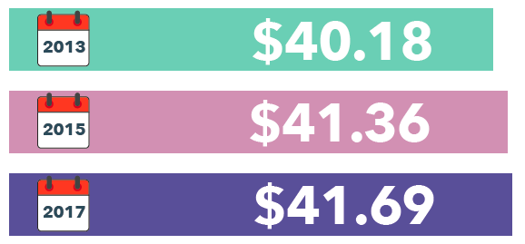
2017 Job Market & Employment Survey Highlights
Average hourly rate increase – first job setting
Notes:
The average hourly rates for a first job setting have increased from 2013 to 2017 and are shown here.
This annual increase is behind the average annual rate of inflation of 1.45%, as reported by the Bank of Canada.

Slide 16
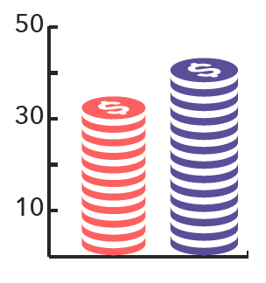
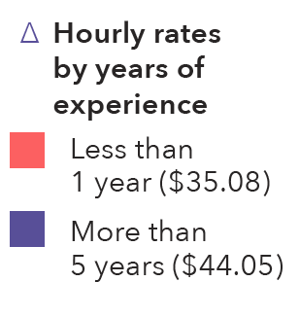
Sondage 2017 sur le marché du travail et de l’emploi
Experience – national average
Employment rate
1.3% unemployment rate among respondents vs. 6.5% Canadian unemployment rate (as of June 2017)
Notes:
In terms of experience, respondents with less than one year of experience earn $35.08 per hour on average and those with more than 5 years of experience earn $44.05 or more per hour on average.
Reported hourly pay rates for the first practice setting vary considerably by province, ranging from the highest hourly pay rate in Alberta at $53.99 to the lowest in New Brunswick at $32.31. These two provinces ranked highest and lowest on the salary scale in 2015 as well. Other provincial average hourly pay rates are:
British Columbia - $43.71
Saskatchewan - $41.82
Manitoba - $41.65
Ontario - $37.54
Newfoundland & Labrador - $37.10
Quebec - $32.90
Nova Scotia - $34.10
PEI - $34.23
Some positions may offer an annual salary or even a commission. In the case of a commission, you wouldn’t typically receive any benefits so make sure that the pay is 8-10% higher than the hourly rate. We encourage you to review the full report for further salary and commission details.
The unemployment rate among respondents is 1.3%, which is well below the current Canadian unemployment rate of 6.5% as of June 2017.

Slide 17
2017 Job Market & Employment Survey Highlights
Category | What are they saying?
Age 20-24 | 39% prefer to be practicing more hours
Age 20-29 | Work for more than one employer
Age 20-34 | Report the greatest salary increase
Age 25-29 | More likely to be paid on an hourly basis
Age 25-39 | 77% are more likely to be working part time
Notes:
Here are some additional statistics that may be of interest to you:
39% of respondents aged 20-24 would prefer to be practicing more hours
Respondents aged 20-29 are most likely to work for more than one employer
Those aged 20-34 report the greatest salary increase
Respondents aged 25-29 are more likely to be paid on an hourly basis
77% of respondents aged 25-39 are more likely to be working part time versus full time

Slide 18
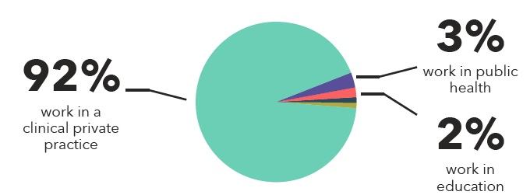
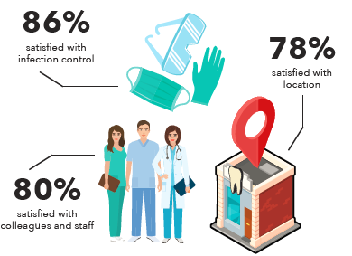
2017 Job Market & Employment Survey Highlights
Workplace & Environment
72% work for single employer
Primary workplace:
Workplace satisfaction:
Notes:
Now let’s look at Workplace and Environment. 72% of respondents work for a single employer which is pretty consistent with 2013 and 2015 results.
In terms of their primary workplace, 92% of respondents work in a clinical private practice setting, followed by 3% in public health and 2% in education.
Respondents report being most satisfied with infection control practices, colleagues and staff, and location.

Slide 19
2017 Job Market & Employment Survey Highlights
Independent Practice Owners
46% owned practice for 1 to 5 years
61% are store-front/fixed location businesses (up from 50% in 2015)
31% are mobile practices (down from 44% in 2015)
Owned practice 6-10 years has increased:
2013 8%
2015 22%
2017 30%
Notes:
In terms of Independent Practice Owners, 46% are relatively new, having owned their practice for 1 to 5 years.
Most independent practices are store-front businesses followed by mobile practices.
Levels of satisfaction with independent practice appear to be very high, with 70% of respondents rating their satisfaction as very satisfied or satisfied.
It is fantastic to note that between 2013 and 2017, the percentage of respondents who have owned their independent practice for 6 to 10 years has significantly increased.

Slide 20
Free On-Demand Webinar
cdha.ca/Webinars
Notes:
To get a better understanding of the 2017 survey highlights focusing on trends in compensation segmented by geography and other criteria, we invite you to a watch a free on-demand webinar.

Slide 21
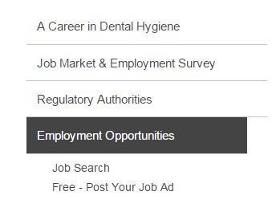
CDHA’s Job Board
cdha.ca/Jobs
Select “Job Search”
Notes:
After you’ve graduated and satisfied your province's regulation requirements, your focus will naturally turn to finding a job as a dental hygienist. Or perhaps your search will start in advance.
CDHA’s job board is a great place for employers and prospective employees to connect and it’s one of the most active areas of CDHA’s website.
To view the current opportunities, visit cdha.ca/jobs and select “Job Search” from the left-hand navigation. You must be logged in to view the information.

Slide 22
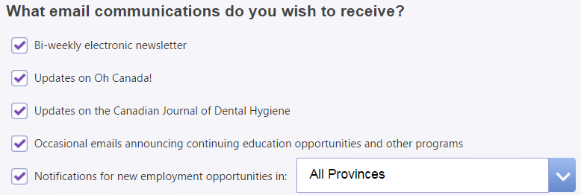
CDHA’s Job Board - Alerts
Receive weekly job alerts
Go to cdha.ca/profileedit
Check the Notifications for new employment opportunities box
Notes:
You can now sign up for CDHA job board alerts and have job postings delivered to your inbox each week. To activate, sign into your online profile and check the "Notifications for new employment opportunities" box.

Slide 23
Applying for a Job
Résumé
List skills, experience, abilities
Format, editing, and design
Cover Letter
First impression
Customize
Research employer
Format, editing, and design
cdha.ca/Careers
Notes:
When you are ready to apply for a job, you will need to provide a résumé and cover letter.
This slide quickly lists what elements should be part of your résumé and other items to keep in mind.
The cover letter, more than the résumé, should be customized for the job you are applying for and the practice you are applying to. Before writing, create a clear picture of how you want to be perceived by the employer, and make a mental list of your best selling points. This is your first impression to the employer. Be sure that it is well written and professional.
More detailed information can be found on the CDHA website.

Slide 24
The Interview
Preparation
Research
Practice
Presentation
Dress professionally, conservatively
Job fit
Position / firm right fit?
Ask questions
cdha.ca/Careers
Notes:
After you’ve landed an interview with your stellar résumé and cover letter, use the interview as an opportunity to show the employer your interest in the position and, in turn, the energy and expertise you will bring to the job.
Getting to this stage shows that the employer has deemed you as qualified for consideration, and the interview is your chance to show that you will put that qualification to good use.

Slide 25
The Interview
Communication and etiquette
Good verbal and non-verbal communication skills
Listen carefully, answer thoughtfully
Arrive early
Concluding the interview
Thank interviewer, restate interest and qualifications
Next steps
Thank you note
Working interviews
cdha.ca/Careers
Notes:
While at the interview and when the interview concludes, there are a number of items to do or keep in mind and a short list is included here. More items are on the CDHA website.
Working interviews, noted here, are sometimes used for dental hygiene positions. If your interview falls into this category, don't be more stressed because of it; think of it as a first day on the job with no obligations. But keep in mind that the prospective employer should pay you. If they decline, take this as a sign to move on.

Slide 26
Contracts
Self-employed vs. employee status
Contract wording will determine if Revenue Canada decides you are employee vs. independent contractor
Contract OF service = employer-employee
Contract FOR services = self-employment
Sample employment & self-employment contracts on CDHA’s website
cdha.ca/Careers
Notes:
When you decide to commit to a position, ensure that there is an appropriate written contract in place. Having a written employment contract allows both you and your employer to have a clear understanding of the expectations that you have of each other. Understanding the difference between self-employment and employee status is extremely important when setting up your relationship with a dentist/dentists and in the creation of your contract. The wording of your contract will determine whether Revenue Canada decides you are an employee or an independent contractor.
When you receive a contract, your potential employer has to give you adequate time to fully review it. It is also recommended that you have a legal professional review the contract.
The main advantages of being self-employed are the freedom and flexibility of scheduling, hours, workplace, etc., as well as the ability to make many more deductions from income taxes. Some disadvantages include the loss of employee benefits such as payment for statutory holidays, vacation pay, protection against wrongful dismissal, ineligibility for maternity/parental benefits and job protection, etc.
If you do make the choice to become a self-employed dental hygienist with a contract for services (self-employed), the most important thing is to be sure of your status. The fines and penalties may be quite substantial when Revenue Canada decides that an arrangement said to be a contract for service is actually a traditional employment relationship. It is very important to seek professional legal advice before setting up a contract for self-employment.

Slide 27
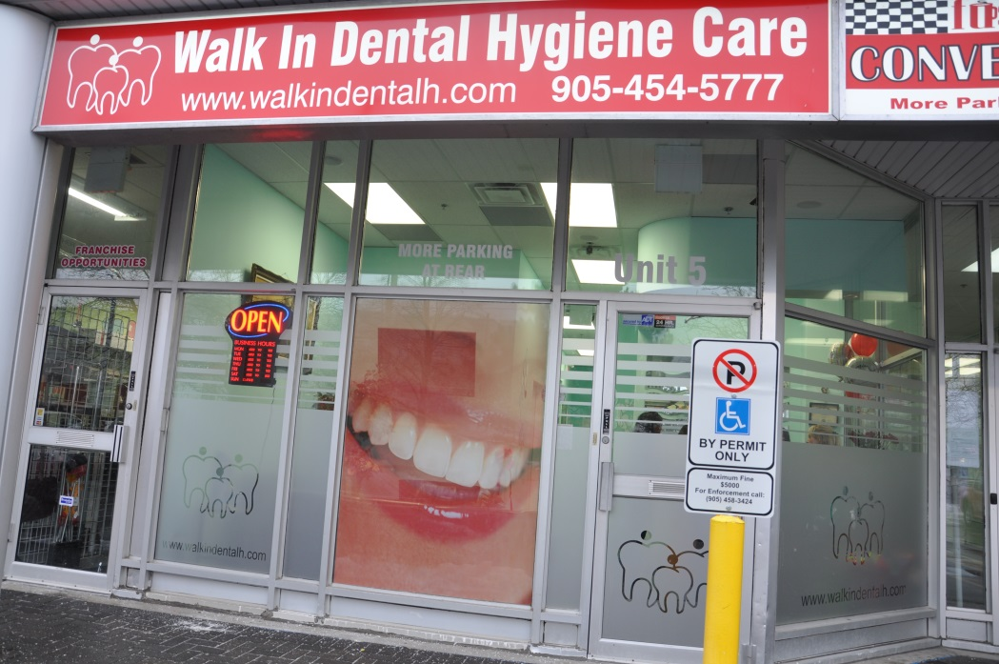
Independent Practice
Own/run business
Work independently or lead a team
Offer clients a wider range of choices
Improve access to dental hygiene care
Notes:
Registered dental hygienists may provide oral healthcare in settings other than a dental office. They may choose to have their own office or operate a mobile practice where they travel to their client's place of residence.
Essentially, dental hygienists in independent practice run their own business. They have the freedom to make their own decisions and offer clients a wider range of choices.
They play an important role in improving access to dental hygiene care.

Slide 28
CDHA’s Commitment to Independent Practice Success
Independent Practice Network (IPN)
Growing community
Unique membership benefits
IP Advisor – Amanda Acker: aacker@cdha.ca
Notes:
Support for independent practitioners is a high priority for CDHA.
A few years ago, CDHA launched the Independent Practice Network which is designed to meet the specific needs of a growing community of Independent Practice dental hygienists. A unique set of membership benefits belong to this community which can be found on our website.
As part of CDHA’s commitment to independent practice success, CDHA hired an advisor by the name of Amanda Acker and her contact information is listed here.

Slide 29
Independent Practice Network:
By the Numbers
PROVINCE | # | PROVINCE | #
Alberta | 125 | Nova Scotia | 15
British Columbia | 116 | Ontario | 767
Manitoba | 16 | Québec* | 8
Newfoundland & Labrador | 14 | Saskatchewan | 10
New Brunswick | 19 | The North and PEI* | 2
*Québec, The North, and PEI do not currently allow dental hygienists to work as independent practitioners.
Notes:
There are over 1,000 dental hygienists registered in CDHA’s Independent Practice Network. Here are the numbers by province.
*Please note that Québec, The North, and PEI do not currently allow dental hygienists to work as independent practitioners.

Slide 30
Membership
Make sure your Student membership is current!
Join:
cdha.ca/Join
Renew:
cdha.ca/Renew
Call:
1-800-267-5235
Notes:
Remember, only current Student members will be eligible for FREE Graduated membership upon successful completion of the National Certification Board Exam.
If you haven’t joined or renewed your Student membership with CDHA, you still have time and it’s easy! Visit cdha.ca/Join and select the Student Membership icon. Or renew at cdha.ca/Renew. Giving us a call is another option.

Slide 31
Contact Us
cdha.ca
info@cdha.ca | membership@cdha.ca
1-800-267-5235 (8:30 am – 4:30 pm ET)
Notes:
CDHA staff members are available to assist you with a variety of dental hygiene or membership inquiries or with any other related questions you may have.
Contact us:
By visiting the CDHA website
by email
Or via telephone

Slide 32
Connect With Us
twitter.com/theCDHA
facebook.com/theCDHA
instagram.com/thecdha
CDHA Online Communities
community.cdha.ca
youtube.com/theCDHA
Notes:
We want to make sure you have the opportunity to connect and share with us and each other on our various online and social media platforms.

Slide 33
The Canadian Dental Hygienists Association
1122 Wellington Street West, Ottawa, Ontario K1Y 2Y7
TEL. 613-224-5515 | TOLL-FREE:1-800-267-5235
info@cdha.ca | membership@cdha.ca
cdha.ca
Notes:
Congratulations on your choice of an exciting career in dental hygiene! Join the CDHA community and let your voice be heard.
Don’t forget: Graduated Student membership is FREE! But you must be a current CDHA Student member before we can bring you to that next step!

Slide 34
Any questions?
Notes:
Thank you for your attention today and good luck!
If you have any questions, I’d be happy to entertain them at this time.

