Slide 1
Your CDHA Roadmap
Student Presentation 2015-2016
Notes:
Congratulations on choosing a rewarding career!
This presentation will introduce you to the Canadian Dental Hygienists Association, also referred to as CDHA, and let you know how membership with CDHA can make the career you are about to begin even more rewarding.
To help you prepare for your career, you will require support and access to resources and professional development opportunities. This is where CDHA can help!

Slide 2
Student Membership is FREE!
Student Membership
New Student Members:
www.cdha.ca/Join
Existing Student Members:
www.cdha.ca/Renew
Notes:
CDHA membership is FREE for students. Join online at www.cdha.ca/Join. For those who are already CDHA Student members, membership must be renewed online by October 31 each year so you don’t lose access to your benefits. Visit www.cdha.ca/Renew.

Slide 3
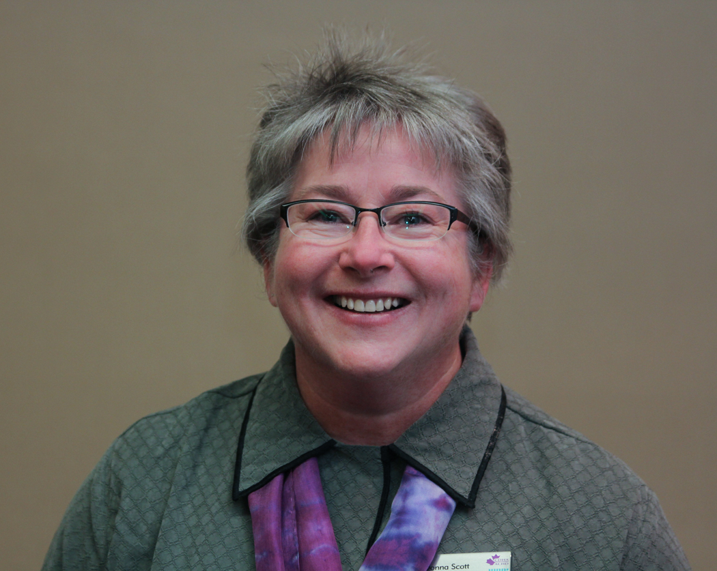
President’s Message
Click on the image below to view a quick video from Donna Scott
Notes:
Let’s view this quick video greeting from CDHA president Donna Scott.

Slide 4
Our Mission
CDHA: Your National Association
CDHA exists so that its members are able to provide quality preventive and therapeutic oral health care as well as health promotion for the Canadian public.
Notes:
CDHA is the collective, national voice of more than 26,850 dental hygienists working in Canada, and we directly represent more than 17,500 members including 1,800 students. The primary role or mandate of the CDHA is to advance the dental hygiene profession, support its members, and contribute to the oral health and the general well-being of the public.

Slide 5
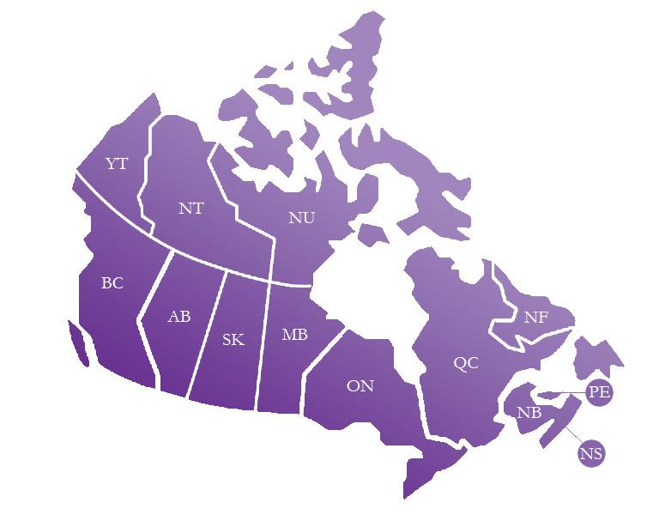
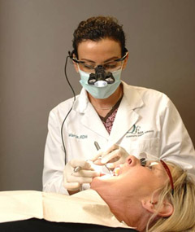
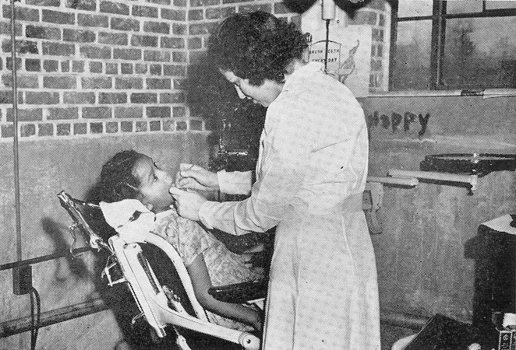
The History of Dental Hygiene
Province/Territory | Year
Ontario | 1947
Saskatchewan | 1948
Prince Edward Island | 1950
Alberta | 1951
British Columbia | 1951
Manitoba | 1952
New Brunswick | 1953
Nova Scotia | 1955
Yukon | 1958
Québec | 1962
Northwest Territories | 1967
Newfoundland & Labrador | 1968
Notes:
Let’s take a look at the historical background of legal recognition of dental hygiene in Canada:
In 1947, dental hygiene was recognized as a health occupation in Ontario.
In 1963, the Canadian Dental Hygienists Association was formed.
In the mid-1970s and particularly from the early 1990s to date, dental hygiene gradually achieved self-regulation and professional status.
Today, dental hygienists can practise independently and without supervision in all areas except PEI, The North and Québec.

Slide 6
Knowledgeable Board & Staff
At Your Service
Board
www.cdha.ca/Board
Staff
www.cdha.ca/Team
Notes:
CDHA is directed by a board of 11 dental hygienists who represent the 10 provinces and the North and is managed by a staff at the national office in Ottawa.
Board and staff focus on four broad areas:
Public Policy Environment
Public Recognition
Professional Practice
Professional Knowledge
CDHA staff members are here to serve you. Consult our website, contact us by phone, email, or social media.

Slide 7
Dental Hygiene Organizations
National Organizations
Provincial Regulatory Authorities
Professional Associations
Provincial Associations
Notes:
There are several key organizations in the profession. Each organization has different roles and responsibilities. Let’s take a look at how each organization functions within the profession.

Slide 8
National Organizations
Commission on Dental Accreditation of Canada (CDAC)
National Dental Hygiene Certification Board (NDHCB)
Notes:
The national organizations associated with dental hygiene include:
The Commission on Dental Accreditation of Canada. CDAC’s primary role is to assess and evaluate dental hygiene programs across Canada in order to ensure they meet national dental hygiene educational standards.
The National Dental Hygiene Certification Board. NDHCB develops and administers the national dental hygiene certification examination for graduates of dental hygiene programs.

Slide 9
Provincial Regulatory Authorities
College of Dental Hygienists of British Columbia (CDHBC)
College of Registered Dental Hygienists of Alberta (CRDHA)
Saskatchewan Dental Hygienists Association (SDHA)
College of Dental Hygienists of Manitoba (CDHM)
College of Dental Hygienists of Ontario (CDHO)
Ordre des hygiénistes dentaires du Québec (OHDQ)
New Brunswick College of Dental Hygienists (NBCDH)
College of Dental Hygienists of Nova Scotia (CDHNS)
Prince Edward Island Dental Council
Newfoundland and Labrador College of Dental Hygienists (NLCDH)
Department of Community Services, Government of Yukon
Department of Health and Social Services, Government of Northwest Territories
Department of Health and Social Services, Government of Nunavut
Notes:
Provincial organizations include the provincial dental hygiene regulatory authorities, which regulate the profession of dental hygiene and register dental hygienists who have met eligibility criteria in their province or territory. The regulatory authorities’ main interest is the overall health and safety of the public.
In order to practise in Canada, dental hygienists must be registered or licensed by the appropriate provincial or territorial dental hygiene regulatory authority. Requirements for registration or licensure and scope of practice vary by province or territory.

Slide 10
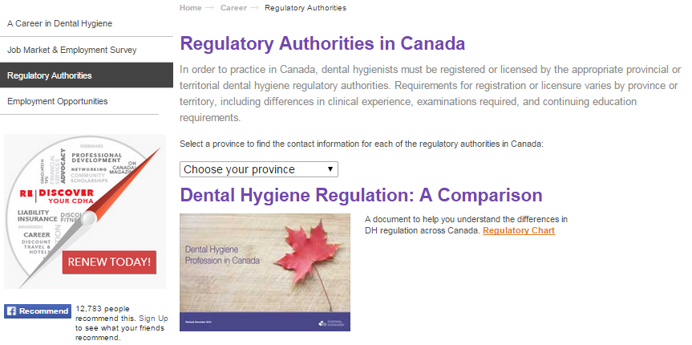
Provincial Regulatory Authorities
Contact Your Provincial Authority:
www.cdha.ca/RegulatoryAuthorities
Choose your province from the drop down menu
Notes:
For additional details, including contact information for each provincial regulatory body, visit the CDHA website.

Slide 11
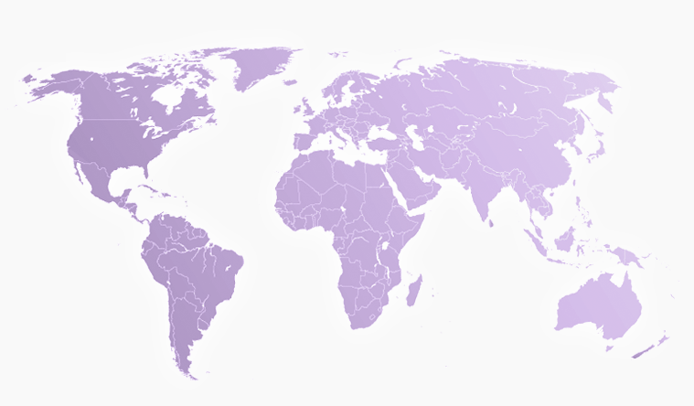
Dental Hygiene
Professional Associations
Local
Provincial
National: CDHA
International: IFDH
Notes:
Dental hygiene professional associations exist to advance the profession and advocate on behalf of their members, dental hygienists, and students. There are different levels of professional associations. For example:
Local associations or societies represent dental hygienists in their immediate communities.
Provincial associations represent dental hygienists on a provincial level. The needs of dental hygienists may vary somewhat from one province/territory to another.
CDHA is the national association advocating on behalf of dental hygienists in Canada regarding issues that affect the profession overall.
The International Federation of Dental Hygienists (IFDH) unites dental hygienists in 23 countries around the world with the goal of promoting global oral health.

Slide 12
Provincial Associations
BC
British Columbia Dental Hygienists Association (BCDHA)
AB
SK
ON
College of Registered Dental Hygienists of Alberta (CRDHA)
Saskatchewan Dental Hygienists Association (SDHA)
MB
Manitoba Dental Hygienists Association (MDHA)
Ontario Dental Hygienists Association (ODHA)
NL
NB
New Brunswick Dental Hygienists Association (NBDHA)
Newfoundland and Labrador Dental Hygienists Association (NLDHA)
NS
College of Dental Hygienists of Nova Scotia (CDHNS)
PEI
Prince Edward Island Dental Hygienists Association (PEIDHA)
Notes:
Provincial associations advocate on behalf of their members, dental hygienists, and students on issues specific to the regulations, scope of duties, and range of services performed by dental hygienists in their particular province. It is important to note that the provincial associations in Alberta, Saskatchewan, and Nova Scotia also act as regulatory authorities in their province.

Slide 13
Provincial Associations
Contact Your Provincial Association:
www.cdha.ca/ProvincialAssociations
Choose an association from the left side menu
Notes:
For the complete list of provincial associations visit the CDHA website.
CDHA encourages you to join your national, provincial and local associations as they all complement each other.

Slide 14
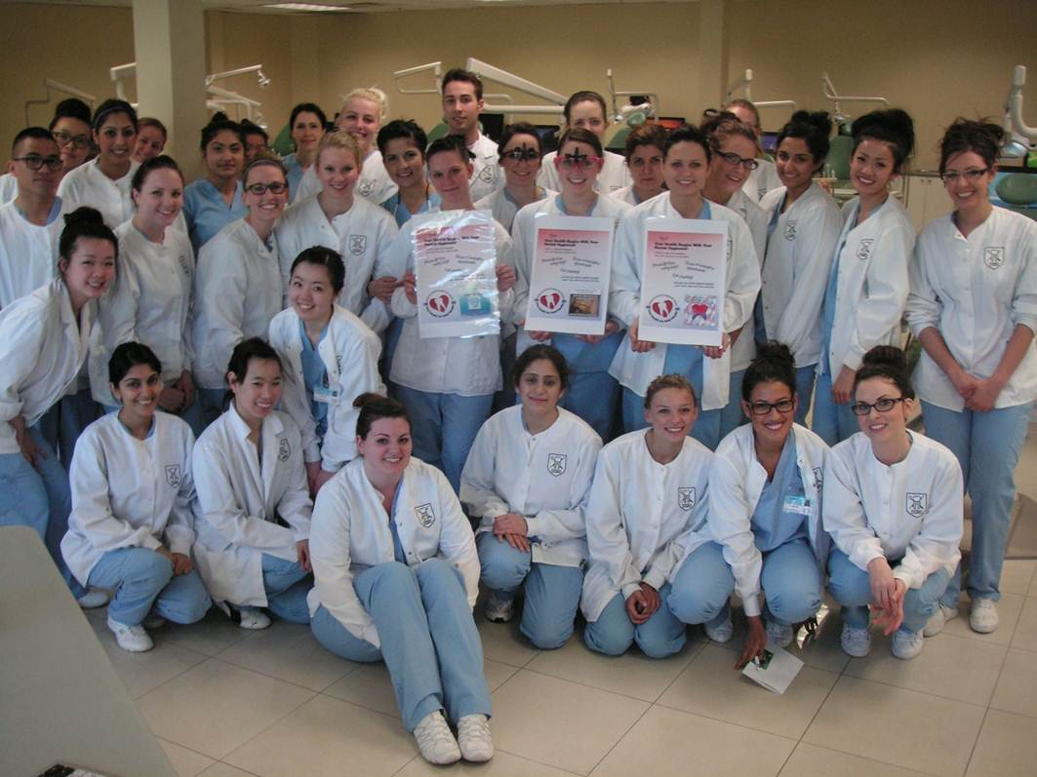
CDHA: Your National Professional Association
WHY JOIN CDHA?
Member Discounts and Benefits including CDHA Perks (NEW!)
Student Leadership Program
Networking and Events
Professional Development and Resources
Awards and Recognition Programs
… and so much more!
Notes:
Why join CDHA?
As a Student Member, you have access to member benefits and discounts, a leadership program specifically for students, networking and events, professional development and resources, and awards and recognition programs to help you get started in your career.

Slide 15
Student Leadership Program
Develop your leadership skills
Connect with other students
Let your voice be heard
Enhance your career and help shape the future of the profession!
Junior Student Representative – fall recruitment
Need more information?
Contact your Student Representative
Notes:
Student representatives serve as the primary liaison between CDHA and faculty and students, promoting CDHA membership, programs, and services. Each fall, a Junior Student Representative is selected to assist the Senior Student Representative.
Becoming a student representative allows you to develop your leadership skills and connect with your association and your peers. Find out who your Senior Student Representative is and consider running for the junior position this fall.

Slide 16
Student Leadership Program
School | Senior Student Representative | School | Senior Student Representative
Algonquin College | Karissa Garneau | John Abbott College | Jessica Bastone
APLUS | Nasim Bahmani | La Cité collégiale | Caroline Savoie
CADH | Dzelila Brka | Niagara College | Kamila Figureido
Cambrian College | Rujul Parikh | ODEI | Thomas Szoke
Camosun College | Brett Hastings | Oulton College | Sydney Nelson
Canadore College | Paula Tos | Oxford College | Johora Pushon
Cégep Garneau | Elizabeth Michaud-Jobin | SIAST | Alyssa Reimer
College of New Caledonia | Chelsea Marjoribanks | St. Clair College | Carina Da Ponte
CNIH | Ashley Boyd | Toronto College | Varinder Brar
Confederation College | Carly Angers | University of Alberta | Julie Collette
Dalhousie University | Amanda Pond | UBC Dentistry | Navdeep Johal
Durham College | Jessica Free | University of Manitoba | Jennifer Bruinooge
Fanshawe College | Emilee Harloff | VCC | Nyca Idolor
George Brown College | Harishni Ramesha | VCDH | Natalie Cuthbert
Georgian College | Katrina Fiorini | VIU | Kaydee Heidema
Notes:
Here is a list of schools and the corresponding Student Representative. Contact yours if you have any questions or feedback for CDHA.

Slide 17
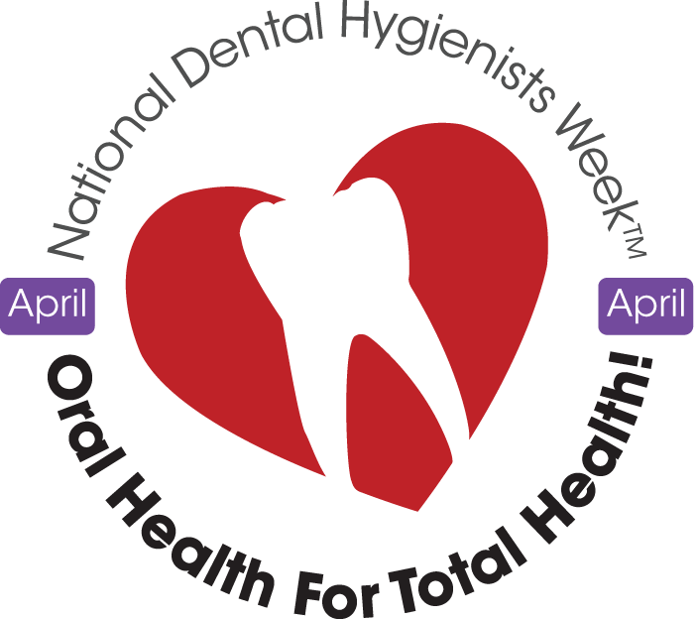
Networking and Events
CDHA National Conference & Annual General Meeting (AGM): October 29-31, 2015, in Victoria, BC
National Dental Hygienists Week™: April 9-15, 2016
Provincial AGMs and Tradeshows throughout the year
Community-Awareness Events:
Gift from the Heart – April 9, 2016
Part of the Change
Listerine Challenge
Notes:
CDHA events include:
National conference – CDHA holds a national conference every two years and a general meeting annually to explore the latest issues, trends, and research impacting dental hygiene practice in Canada.
National Dental Hygienists Week™ – this national event is held annually in April and is dedicated to increasing public awareness of the importance of oral health and the role of dental hygienists.
Watch for CDHA at provincial meetings and dental conferences like the PDC and ODA.
Community-awareness events – CDHA also supports events that help promote oral health in the community and raise awareness of the profession. Some events include Gift from the Heart, Part of the Change and Listerine Challenge.

Slide 18
Professional Development and Resources
Publications
Oh Canada!
CJDH
E-news
Fact Sheets
Code of Ethics
National Entry to Practice Competencies and Standards document
Job Market and Employment Survey
Clinical Practice Guidelines
Position Papers/Statements
… and more!
Notes:
CDHA has many resources for you:
Publications – CDHA offers a wide variety of publication resources for members including:
Oh CANADA! member magazine
The scientific publication Canadian Journal of Dental Hygiene (CJDH)
eNewsletters issued twice monthly
Clinical practice guidelines
Evidence-based position papers and statements
And more

Slide 19
Professional Development and Resources
Professional Development
Conferences
Courses
Webinars
Workshops
www.cdha.ca/Education
Notes:
CDHA also offers many professional development opportunities, in person conferences and workshops as well as live and on-demand online courses and webinars on a variety of dental hygiene topics. Most opportunities are available to students at a discounted rate and some are even free.
To view the full list of conferences, workshops, courses, and webinars in CDHA’s online library, please visit the CDHA website.

Slide 20
Professional Development and Resources
www.cdha.ca
Your primary source
of information!
Notes:
The CDHA website is your primary source of information.

Slide 21
Professional Development and Resources
CDHA Online
Job Board: www.cdha.ca/Jobs
NEW! Consumer Website: www.dentalhygienecanada.ca
Notes:
On the CDHA website, you can navigate to the job board which is a great place for new grads to look for job opportunities.
And please visit our new consumer website at www.dentalhygienecanada.ca to access informative oral health information, fun and educational activities for kids and our “Find an Independent Dental Hygienist” search engine.

Slide 22
Discounts
GoodLife Fitness: close to 50% off the regular individual membership
Worldwide Hotel Discounts: Access to 10-50% discounts on business or leisure travel for members, family and friends
National Car Rental, CDHA eBookstore, FedEx discounts
www.cdha.ca/Benefits
Notes:
CDHA is constantly striving to enhance the value of your membership. The association is pleased to offer 15 member benefit programs including:
GoodLife Fitness, which offers close to 50% off annual memberships.
Access to a worldwide inventory of hotels at unbeatable rates.
Discounts for National Car Rental, the CDHA eBookstore, FedEx and more!
Visit the CDHA website for more information.

Slide 23
Free with Membership
e-CPS
Online Compendium of Pharmaceuticals and Specialties
$349 value but you can access it for FREE!
www.cdha.ca/e-cps
Notes:
As a CDHA member, you also have FREE access (a $349 value) the online Compendium of Pharmaceuticals and Specialties (e-CPS), which provides web and mobile access to the most current Canadian drug information available to help you stay up to date.

Slide 24
Free with Membership
Our NEWEST benefit: CDHA Perks
Access to more than 365,000 shopping, dining, travel, and entertainment discounts across North America
Click on the image to view a quick video
www.cdha.ca/CDHAPerks
Notes:
Our newest member benefit is CDHA Perks. Enjoy instant access to more than 365,000 shopping, dining, travel, and entertainment discounts across North America. Let’s watch a quick video about the program.

Slide 25
Insurance Programs
Student Members have access to:
Home and Auto Insurance Savings
Financial Advisor Services
Future benefits include:
Individual Professional Liability Insurance Program
Future benefits could include:
Disability, Life and Accidental Death Coverage
Clinic Business Package Insurance Program
www.cdha.ca/Benefits
Notes:
As a CDHA Student Member, you have access to:
Savings on your home and auto insurance through preferred group rates (note that group auto insurance rates are not available in Manitoba, Saskatchewan or British Columbia).
Financial advisor services.
Once you’ve graduated and entered the workforce, CDHA has a variety of additional benefits including:
Individual professional liability insurance.
Disability, life and accidental death coverage.
Clinic business package insurance.
For more information on all of our member benefits, visit the CDHA website.

Slide 26
Graduated Student Membership
The Next Steps in Your Career After Graduation
CDHA’s FREE Graduated Student membership category includes Professional Liability Insurance
Notes:
After graduating from your dental hygiene school and successfully completing the National Dental Hygiene Board Exam, your CDHA Student membership will automatically be transitioned to a Graduated Student membership. Membership is still FREE and now it includes professional liability insurance coverage of up to $5 million aggregate until December 31 of that year.

Slide 27
Now it’s Your Turn
Ready to get involved or renew your membership with CDHA?
Join online:
www.cdha.ca/Join
Renew online:
www.cdha.ca/Renew
Call us:
1.800.267.5235
Notes:
Joining is easy and it’s FREE. Visit www.cdha.ca/Join and select the Student Membership icon. Remember, those who are already CDHA Student members must renew their membership online by October 31 each year and should watch for a renewal notification by email.

Slide 28
Contact Us
www.cdha.ca
1.800.267.5235
(8:30 a.m. – 5 p.m. ET)
info@cdha.ca
membership@cdha.ca
Notes:
CDHA staff members are available to assist you with a variety of dental hygiene or membership inquiries or with any other related questions you may have.
Contact us:
By visiting the CDHA website;
Via telephone – office hours are from 8:30 a.m. to 5:00 p.m. ET;
Or by email

Slide 29
Connect With Us
www.twitter.com/theCDHA
www.facebook.com/groups/CDHAstudents
www.facebook.com/theCDHA
CDHA Online Communities
community.cdha.ca
www.youtube.com/theCDHA
Notes:
We want to make sure you have the opportunity to connect and share with us and each other on our various online and social media platforms.

Slide 30
The Canadian Dental Hygienists Association
1122 Wellington Street West
Ottawa, Ontario K1Y 2Y7
t. 613.224.5515 | tf. 1-800-267-5235
f. 613.224.7283
info@cdha.ca | membership@cdha.ca
www.cdha.ca
Notes:
Congratulations on your choice of an exciting career in dental hygiene! Join the CDHA community and let your voice be heard. Don’t forget: student membership is FREE!
We hope this presentation has answered all of your questions about CDHA. Feel free to contact us or your student representative if you have any other questions. CDHA is here for you!

