Slide 1
Notes:
Congratulations on your upcoming graduation! My name is (bio here)
This presentation will outline what lies ahead as you begin a rewarding career in dental hygiene. To help you prepare, you will require support and access to resources. This is where CDHA can help!

Slide 2
CDHA’s Mission
Notes:
So let’s talk a bit about why CDHA exists. Does anyone know what CDHA’s mission is?
[ pause and see if anyone responds ]
By [ using the thumbs up emoji / raising your hand ], who thinks CDHA is the voice of the public? Okay…
By [ using the thumbs up emoji / raising your hand ] again, who thinks we are the voice of dental hygienists?
For those of you who reacted to the 2nd question, you are correct! CDHA is the voice of dental hygienists.

Slide 3
Notes:
CDHA is the collective, national voice of more than 31,000 dental hygienists working in Canada, and they directly represent more than 22,000 members including students.
The primary role or mandate of CDHA is to advance the dental hygiene profession, support its members, and contribute to the oral health and the general well-being of all persons living in Canada.

Slide 4
National Dental Hygienists Week™
Notes:
As the collective national voice, CDHA organizes an awareness campaign each April since it’s oral health month.
An important part of the celebration is National Dental Hygienists Week. This annual event focuses on the importance of maintaining good oral health practices and helping Canadians understand the role and importance of the dental hygiene profession. Hopefully, you’ll celebrate the profession with CDHA and put your purple on!
The 2023 advertising theme focussed on kids because of the interim Canada Dental Benefit and here’s what one of the outdoor billboards featured.

Slide 5
National Dental Hygienists Week™
Notes:
Another part of CDHA’s advertising campaign includes a national TV ad so let’s check out the commercial that ran in 2023.
TO PRESENTER: if you’re having issues, open a separate tab/window and share/play https://www.youtube.com/watch?v=6skhjLOI9QI

Slide 6
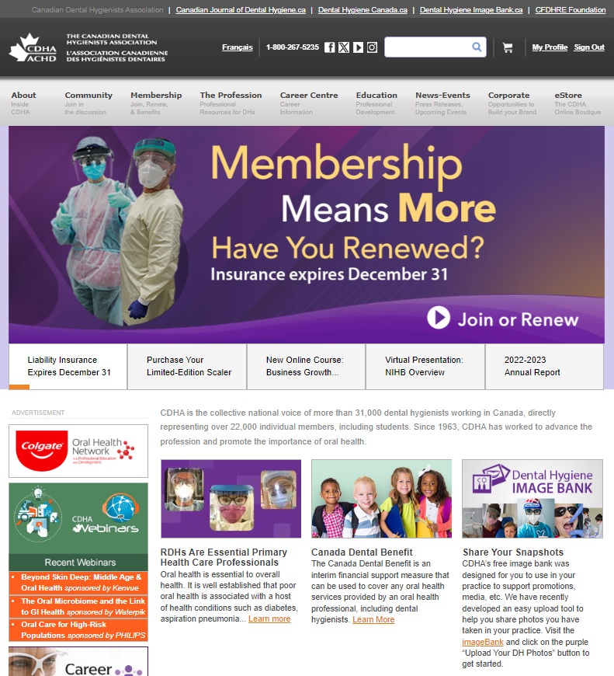
Website
Notes:
As we go through this presentation I’m going to mention where you can find some of the membership benefits or resources on CDHA’s website. This slide shows you what the site looks like. Under each section is a drop-down menu to further guide you. The mobile site has a slightly different experience, but you still have access to all the sections and drop-down menus.

Slide 7
Dental Hygiene Organizations
National Organizations
Provincial Regulatory Authorities
Professional Associations
Provincial Organizations
Notes:
As a refresher, let’s dive a bit further into the profession.
Within dental hygiene, there are several key organizations, and each organization has different roles and responsibilities.
So let’s take a look at how each one functions within the profession.

Slide 8
National Organizations
Commission on Dental Accreditation of Canada (CDAC)
Federation of Dental Hygiene Regulators of Canada (FDHRC)
Notes:
The national organizations associated with dental hygiene include:
The Commission on Dental Accreditation of Canada. CDAC’s primary role is to assess and evaluate dental hygiene programs across Canada in order to ensure they meet national dental hygiene educational standards.
And the Federation of Dental Hygiene Regulators of Canada. This organization gathers all of the provincial regulatory bodies across Canada. Their mission is to provide national leadership in dental hygiene regulation for the protection of the public. They also develop and administer the national dental hygiene certification exam.

Slide 9
Board Exam
Upcoming Examinations | Application Deadline Dates
January 24–25, 2024 | November 24, 2023 Transfer and revocation deadline is January 2, 2024
May 22–23, 2024 | March 22, 2024 Transfer and revocation deadline is April 29, 2024
September 2024 (exact dates TBC) | July 2024
Notes:
Speaking of the board exam, here are the next 2 confirmed exam dates—January and May. Dates for the September exam are still to be confirmed and all the pertinent details can be found on the Federation’s website including four different, but equivalent, online preparatory tests.
And, as a note, once you’ve taken the exam, it has been about 28 days on average for the results to be posted. And you might be wondering, what happens with my CDHA membership after the board exam? We’ll get to that shortly.

Slide 10
Provincial Regulatory Authorities
Department of Health and Social Services, Government of Nunavut
Department of Community Services, Government of Yukon
Notes:
Provincial organizations include the provincial dental hygiene regulatory authorities, which regulate the profession of dental hygiene and register dental hygienists who have met eligibility criteria in their province or territory. The regulatory authorities’ main interest is the overall health and safety of the public. They’re there to ensure that dental hygienists who practice in their provinces follow the required processes and protocols and follow continuing education guidelines for that province.
In order to practise in Canada, dental hygienists must be registered or licensed by the appropriate provincial or territorial dental hygiene regulatory authority. Requirements for registration or licensure and scope of practice vary by province or territory. So it’s important to check with your province or territory’s regulatory authority regarding the steps to register for your license.

Slide 11
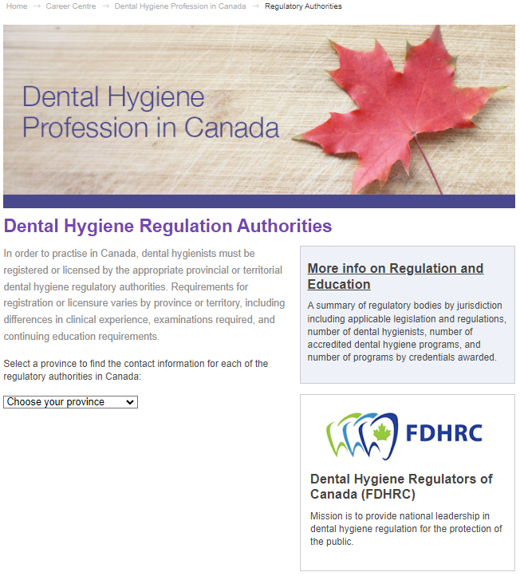
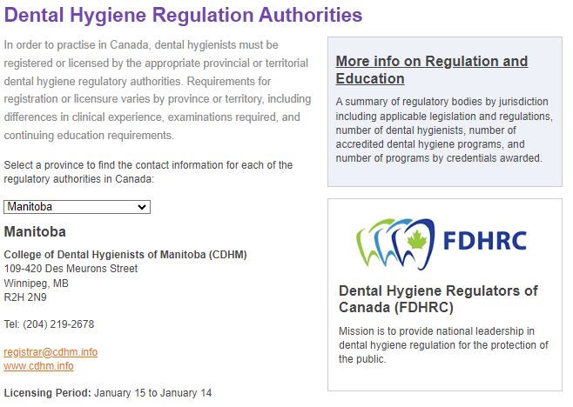
Provincial Regulatory Authorities
Notes:
In the screen shot on the left, this is the regulatory authority main page which can be found under the “Career Centre” section on CDHA’s website.
Simply select the province or territory you want from the drop-down list and you’ll see the details of the corresponding regulatory authority. In our example on the right, Manitoba was selected.

Slide 12
Professional Associations
Local
Provincial
National: CDHA
International: IFDH
Notes:
Dental hygiene professional associations exist to advance the profession and advocate on behalf of their members, dental hygienists, and students. There are different levels of professional associations. For example:
Local associations or societies represent dental hygienists in their immediate communities. As a new graduate these can be a great place to meet experienced dental hygienists and get continuing education.
Provincial associations represent dental hygienists on a provincial level. The needs of dental hygienists may vary somewhat from one province/territory to another.
CDHA is the national association advocating on behalf of dental hygienists in Canada regarding issues that affect the profession overall as well as support provincial association efforts.
The International Federation of Dental Hygienists (IFDH) unites dental hygienists in 23 countries around the world with the goal of promoting global oral health. If you’re thinking of practising dental hygiene in another country at some point, IFDH is a great place to start.

Slide 13
Professional Associations
Notes:
CDHA member Wanda Fedora from Nova Scotia is the president of the International Federation. CDHA is thrilled to have a Canadian in this leadership position!

Slide 14
Provincial Organizations
Notes:
Provincial organizations advocate on behalf of their members, dental hygienists, and students on issues specific to the regulations, scope of duties, and range of services performed by dental hygienists in their particular province.
CDHA encourages you to join your national, provincial, and local associations as they all complement each other.

Slide 15
CDHA Membership
Notes:
So why should you be a part of CDHA? The answer is simple. Your national professional association does MORE for you: more learning, more connections, more support, more public recognition, and more savings. Let’s watch a brief video highlighting one of these areas. To watch the other short videos in this series, check out CDHA’s website.
[ TO PRESENTER: if you’re having issues, open a separate tab/window and share/play: https://youtu.be/W7T2HgU7RWg ]

Slide 16
FREE Graduated Student Membership
After Board Exam
cdha.ca/studentupgrade
Notes:
So what happens after you pass the board exam? You can then upgrade your CDHA Student membership to Graduated Student membership. Membership is still FREE and now it includes professional liability insurance coverage of up to $5 million aggregate until December 31st of that year. Professional liability insurance is required to register for your license and practise in the profession.

Slide 17
After Board Exam
Board exam results posted
CDHA updates system
Student upgrades online
Student downloads PLI certificate
Student registers for license
You’ll need: your NDHCE Candidate ID #
Upgrade at: cdha.ca/studentupgrade
Notes:
Here’s a quick overview of the steps you take once the board exam results are posted. In order to upgrade to Graduated Student membership, you’ll need your NDHCE Candidate ID #, which is the number used to write your exam and verify your account. You’ll find this in your exam seat booking email.
If you don’t happen to receive an email from CDHA prompting that it’s time to upgrade, you can still upgrade—just visit the student upgrade link and follow the prompts.

Slide 18
Professional Liability Insurance
Notes:
Just to clarify, there is a difference between professional liability insurance and disability insurance. Professional liability, or malpractice, insurance protects you against liability or allegations of liability for injury or damages that have resulted from a negligent act, error, omission, or malpractice that has arisen out of your professional capacity as a dental hygienist. An example of this would be if you didn’t put safety glasses on your client and dropped an instrument on them damaging their eye or didn’t perform an oral cancer screening and missed early detection of oral cancer for a client. Again, this type of insurance is included with your membership at no extra cost and is provided by our broker, BMS Canada. It also provides coverage for legal expenses in the event of an investigation by your regulatory body.
Then there’s long-term disability insurance which is available as an insurance add-on at a cost through another provider and it helps replace your lost income and helps protect your lifestyle if you are unable to work due to illness or injury. This could be a work or home life injury or illness. CDHA has had dental hygienists contact them after they have a repetitive stress injury or broke a leg while skiing and are unable to work for months. This means no income. After the injury, the member then asks about disability insurance. At that point it’s too late. This profession can take its toll on the body, so you’ll want to follow all of those ergonomic and instrumentation guidelines our instructors have been stressing when you’re out in practice. They make a difference and will help you have a long career.
Going back to professional liability insurance, included with your graduated student membership, I wanted to note that:
If you change provinces, the insurance policy moves with you.
There is no deductible.
The insurance policy will only be valid once you are registered and have your license to practice.
Let’s watch a brief video that explains professional liability insurance, why you need, and what it covers. You can also find the video on CDHA’s website at cdha.ca/insurance.
(Note to presenter, link to video is https://youtu.be/Lb5eQ_A_WGU)

Slide 19
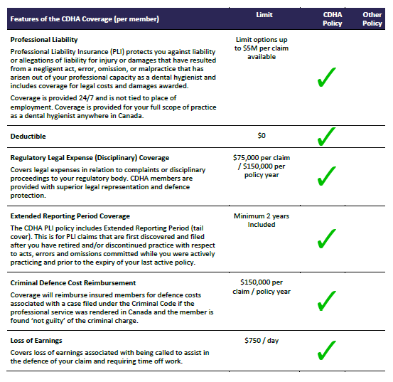
PLI Resources
Notes:
With more then 18,000 participating members, CDHA’s PLI program is the largest one for dental hygienists and serves the dental hygiene profession only. CDHA works closely with their broker, BMS, to ensure that BMS has a broad and deep understanding of the profession’s insurance needs and practice landscape.
You can find the video we just watched plus an extended video that talks about the risk and liability for dental hygienists, what the policy includes, examples of claim scenarios, and more. You can find these videos and some great downloadable resources on CDHA’s insurance page.
Pay particular attention to the coverage comparison chart.

Slide 20
Professional Liability Insurance
cdha.ca/insurance
Notes:
To gain a further understanding of the risks and liabilities associated with professional practice, watch a FREE webinar featuring presenters from CDHA’s liability insurance program partners. They review common claims made against dental hygienists, including complaints to regulatory bodies and civil claims.

Slide 21
QUIZ TIME!
Prize at stake
Notes:
At this time I’d like to ask a quiz question and a prize will be awarded for the correct answer. If you think you know the answer, please [ enter your response in the chat / raise your hand ]. The 1st correct response wins!
I’ll give you a moment to get ready.

Slide 22
Quiz Question
True or False?
CDHA’s Graduated Student membership costs $50.
FALSE: Graduated Student membership is FREE!
Notes:
TRUE or FALSE? CDHA’s Graduated Student Membership costs $50.
[ TO PRESENTER – if virtual presentation, after about 10-15 seconds, check the chat feature to see if you have a winner. ]
Congrats to [ name here ]. They correctly answered…
FALSE. Graduated Student Membership is actually FREE.

Slide 23
Professional Development
Unlimited FREE webinars
Conferences
Courses
Workshops
Notes:
Once you’re registered to practice, you’ll need to formulate an ongoing professional development plan and CDHA can help you stay on track. Quality assurance programs vary greatly across the country, and the standards for these programs are set by the provincial regulatory bodies.
CDHA offers many educational opportunities in the form of in-person conferences and workshops as well as online courses and webinars on a variety of dental hygiene topics—including cannabis, vaping, oral cancer, and ergonomics.
As a dental hygienist, you will engage in lifelong learning in a profession that is always evolving. With CDHA membership, you have access to unlimited FREE webinars which is going to save you hundreds of dollars! CDHA knows how important it is for you to save money… and this will help!

Slide 24
Notes:
CDHA holds a summit and a national conference on alternating years. The summit focuses on leadership and also has a professional development component.
CDHA’s conference explores the latest issues, trends, and research impacting dental hygiene practice in Canada. The next one is in Niagara Falls in October 2024. This event offers a chance for you to build relationships with like-minded dental hygiene professionals from across the country. It’s also a great place to connect, discuss, and engage with presenters for a richer, more meaningful learning experience. Plus, there’s always great food and social activities! Aside from the incredible continuing education, it’s just a great time!

Slide 25
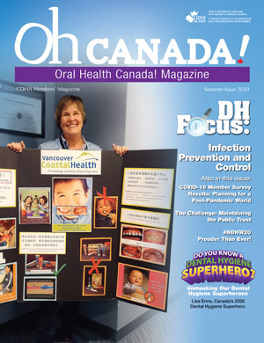
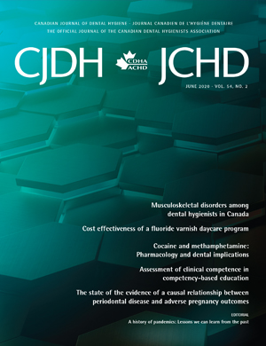
Resources
Notes:
CDHA also offers a wide variety of publication resources for members including:
Oh Canada! member magazine, issued 3 times per year. Maybe one day you’ll write an article for one of the columns or “Focus” topics.
A peer-reviewed research publication Canadian Journal of Dental Hygiene (CJDH) also issued 3 times per year. The Journal is indexed in Medline and also has a dedicated website. Check it out!
CDHA also offers:
eNewsletters issued twice monthly

Slide 26
Resources
Fact Sheets
Code of Ethics
Clinical Practice Guidelines
Position Papers/Statements
Notes:
They also offer:
Clinical practice guidelines
Evidence-based position papers and statements
And more!
Most of these items can be found on the CDHA website under The Profession section.

Slide 27
dentalhygienecanada.ca
Notes:
Additional resources can be found on CDHA’s bilingual consumer website at dentalhygienecanada.ca. You’ll find all kinds of educational oral health information for clients of all ages. Topics include fluoride treatments, toothbrushing tool kit, tobacco, diabetes, heart health, oral health care tips for seniors, gingivitis, and more.
You may even find these resources useful in client care clinics while you’re finishing up at school. There’s nothing better than providing your oral health education to a client and then handing them a resource they can read at home to reinforce your message. A link to Dental Hygiene Canada can be found along the top of the CDHA website.

Slide 28
Free with Membership
Notes:
As a CDHA member, you have FREE access to:
Perkopolis – where you can save on movies, entertainment, travel, shopping, dining, and more… Visit CDHA’s website to register and download their mobile app!
Endless Savings & More, which provides discounts and savings with many of Canada’s largest organizations. They also offer a mobile app which you can find on CDHA’s website.
And last but not least is the CDHA career centre. This is a great place for grads to look for career opportunities. We’ll talk more about this shortly.

Slide 29
Free with Membership
cdha.ca/healthyworkplace
Notes:
CDHA believes that every dental hygienist is entitled to work in a healthy and respectful environment. In 2018, CDHA circulated a national healthy workplace survey to practising members. Based on those results, a vision of a healthy and respectful workplace for dental hygienists was developed. CDHA wants to ensure dental hygienists are being supported in the ways they need to have a healthy and respectful workplace.
In fall 2023, CDHA surveyed members again and will share results this year.

Slide 30
Free with Membership
Notes:
In addition to the vision statement, CDHA created several free resources and materials for members that can contribute to the promotion of healthy and respectful workplaces. They include the vision of a healthy and respectful workplace for dental hygienists, ergonomic tips and stretching, links for yoga and meditation, and resources on how to address sexual harassment or abuse and violence in the workplace. Explore these sections today!

Slide 31
Free with Membership
Notes:
In the healthy and respectful workplace section, you’ll even find a video series called Conversations to Build Collaborative Workplaces. The videos give guidance and confidence to dental hygienists who are seeking to bridge a divide with a member on their dental team. Unfortunately, work, and life in general, is not all sunshine and roses and this video series can provide you with the tools you need, and give you confidence, when you know you’re going to have a challenging conversation in your workplace. Or even in your personal life.

Slide 32
Free with Membership
Notes:
As graduating students, CDHA encourages you to view this series and there’s an introductory video to get you started. Note that the videos and resources are exclusive to members.
I hope you will take some time to watch the full videos.
Let’s watch the sneak preview of the introductory video.
[ TO PRESENTER: here’s the link just in case: https://youtu.be/KgT_10vn4M0 ]

Slide 33
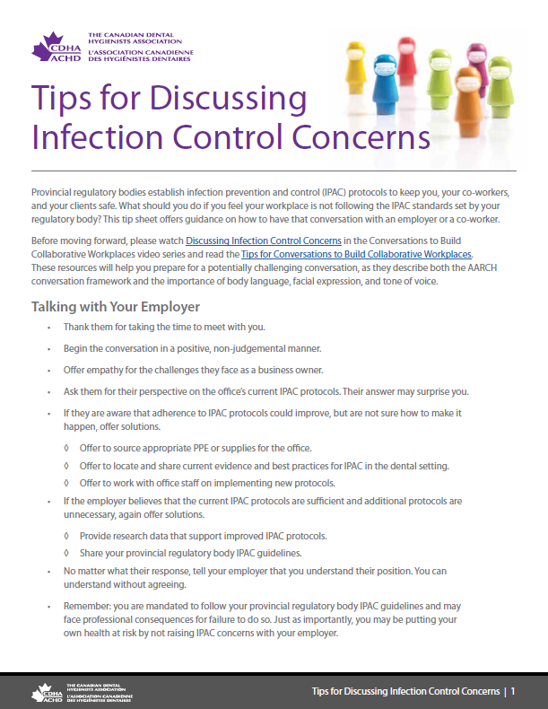
Free with Membership
Notes:
CDHA also offers further guidance with downloadable resources such as Tips for Conversations to Build Collaborative Workplaces, Tips on How to Address Bullying and Harassment, and Tips to Address Infection Control Concerns.

Slide 34
Free with Membership
Counselling Services
Workplace, stress, and family issues
Available 24/7
Notes:
When you transition to an Active/Practising member, your membership will also include counselling services through a member and family assistance program through Homewood Health.
It’s a professional and proactive service to support you through a wide range of personal, family, and work-related concerns and is available 24 hours a day, every day of the year. Their website also has great articles and resources, as well as access to the counselling services.

Slide 35
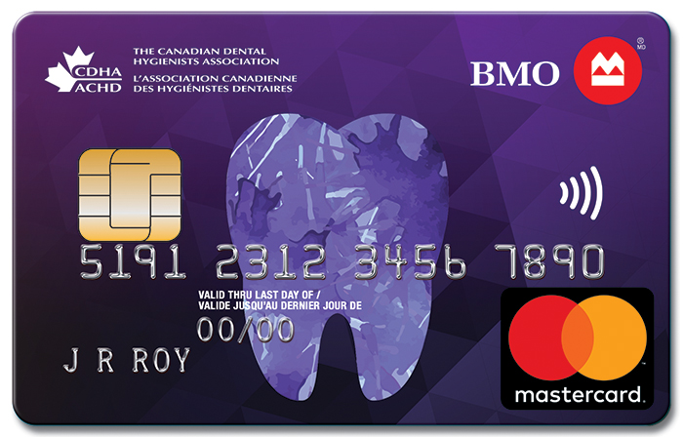
Discounts
GoodLife Fitness
Worldwide Hotel
Insurance programs
Loupes
… and more!
Notes:
CDHA is constantly striving to enhance the value of your membership. The association is pleased to offer several discounted programs including:
GoodLife Fitness – which provides you and your family preferred membership pricing
A worldwide inventory of hotels at unbeatable rates
Additional insurance programs including competitive home and auto insurance and a variety of personal health insurance plans including the disability insurance I mentioned earlier.
…and more!

Slide 36
QUIZ TIME!
Prize at stake
Notes:
I have another quiz question and a prize to give away for the correct answer. If you think you know the answer, please [ use the chat feature to submit / raise your hand ]!

Slide 37
Quiz Question
Where is CDHA’s next national conference?
ANSWER: Niagara Falls in October 2024
Notes:
Where is CDHA’s next national conference?
[ TO PRESENTER – if virtual presentation, after about 10-15 seconds, check the chat feature to see if you have a winner. ]
Congrats to [ name here ]. The answer is Niagara Falls and it’s taking place October 2024.

Slide 38
cdha.ca/jobsurvey
Executive Summary | Full Report | Report by Province
Notes:
Now, let’s jump into the topic of jobs.
Every other year, CDHA surveys members in order to obtain a national perspective of employment and compensation trends and workplace environment.
Once the data is compiled, CDHA members, including students, receive complimentary access to the executive summary, full report and report by province/territory. Keep in mind this information can be helpful when negotiating an offer of employment.
Let’s go ahead and look at some of the highlights of the 2023 survey results.

Slide 39
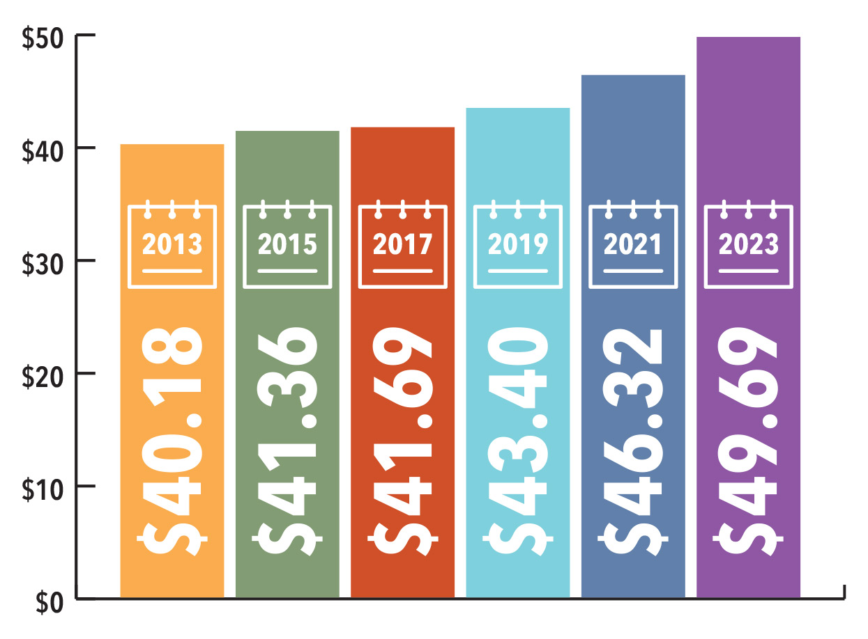
Job Market & Employment Survey
Average Hourly Pay Rate
Notes:
The average hourly rate for respondents in 2023 is $49.69 including bonuses and commissions, if applicable, which continues the trend of increasing hourly wages.

Slide 40
Job Market & Employment Survey
Average Hourly Pay Rate
Alberta - HIGHEST | $58.86 |  | New Brunswick - LOWEST | $39.17
British Columbia | $54.38 |  | Nova Scotia | $41.17
Saskatchewan | $51.32 |  | Prince Edward Island | $42.57
Manitoba | $47.66 |  | Newfoundland & Labrador | $51.58
Ontario | $45.94 |  | The North | N/A
Quebec | $47.69
Notes:
Here’s the provincial/territory breakdown. Consistent with previous years, Alberta has the highest average effective hourly rate and New Brunswick continues to have the lowest average hourly rate, but we are seeing a higher growth rate in New Brunswick over the past 10 years.
For the North, CDHA is still waiting on the information. In 2021, there wasn’t enough data to report but in 2019, CDHA reported $47.80.

Slide 41
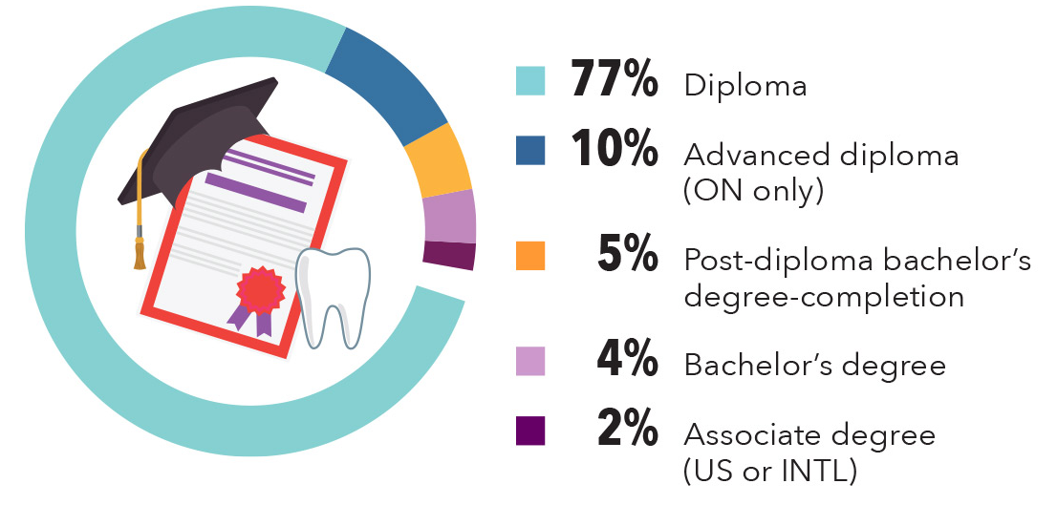
Job Market & Employment Survey
Education & Mean Hourly Wages
Earn 11% more than those with diploma
Notes:
The highest level of dental hygiene education completed by respondents is a dental hygiene diploma (87%), followed by a bachelor’s degree (9%) and a master’s degree (0.3%).
Respondents with a bachelor’s degree in dental hygiene earn 11% more than those with a diploma in dental hygiene.

Slide 42
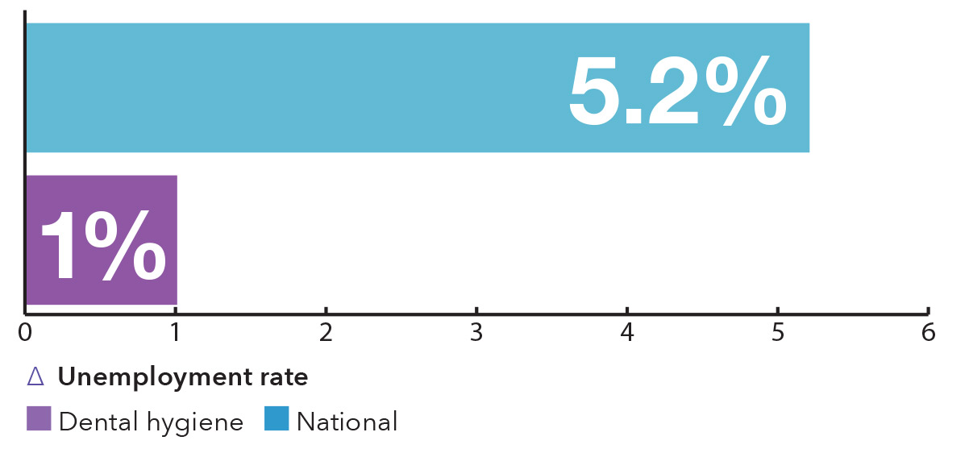
Job Market & Employment Survey
Unemployment Rate
Notes:
The unemployment rate among respondents was 1%, which is well below the 5.2% national unemployment rate for Canada in May 2023.

Slide 43
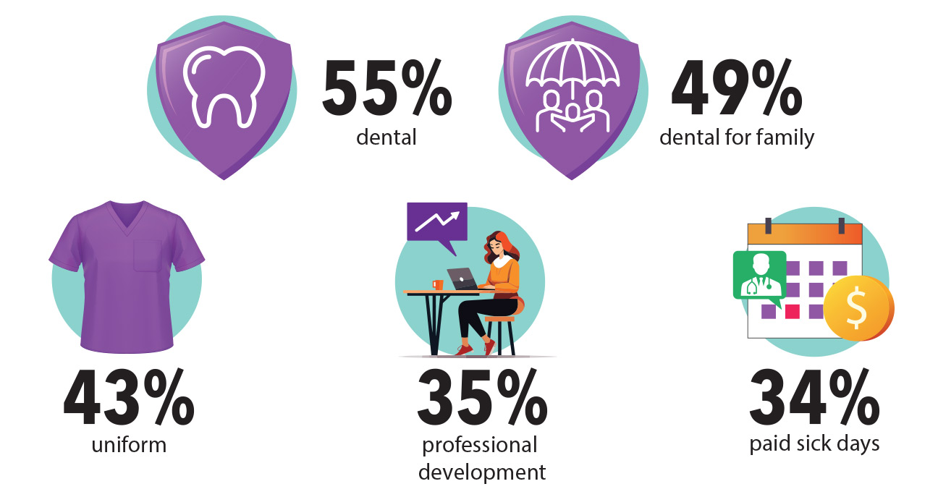
Job Market & Employment Survey
Top 5 Benefits
Notes:
87% of respondents receive at least one employment benefit. The top five benefits received are dental care for themselves (55%), dental care for family (49%), uniform allowance (43%), professional development (35%), and paid sick days (34%).

Slide 44
Job Market & Employment Survey
Written Contracts
Notes:
The number of respondents with a written employment contract continues to trend upwards, from 40% in 2015, to 54% in 2021, to 59% in 2023. As in previous years, employment contracts are most common in Ontario.
An employment contract outlines duties and responsibilities on both the employer and the employee’s part.

Slide 45
Negotiating a Compensation Package
Notes:
CDHA has two resources that are perfect for new grads as they look for that first job, Negotiating a Compensation Package as an Employee and Negotiating a Compensation Package as an Independent Contractor. We’ll talk about the difference between an employee and an independent contractor in a bit.
When starting at a new place of employment, you want to begin on the best possible terms… for you!

Slide 46
Career Centre
cdha.ca/careercentre
Notes:
After you’ve graduated and satisfied your province's regulation requirements, your focus will naturally turn to finding a position as a dental hygienist. Or perhaps your search has already started!
Navigate to CDHA’s online career centre which is a great place to look for career opportunities. It’s one of the most active areas of the website with over 1,100 positions posted annually.
And, it has been revamped in 2023 where you can:
Search the latest employment opportunities, now by city or province;
Find out about salaries in your area;
Learn about healthy and respectful workplaces;
Access resources to help build your career; and more!
With new postings almost daily, the Career Centre is the perfect platform for connecting with recruiters looking for your specialized skill set.

Slide 47
Weekly Alerts
Notes:
You can also sign up for alerts and have career postings delivered to your inbox each week.

Slide 48
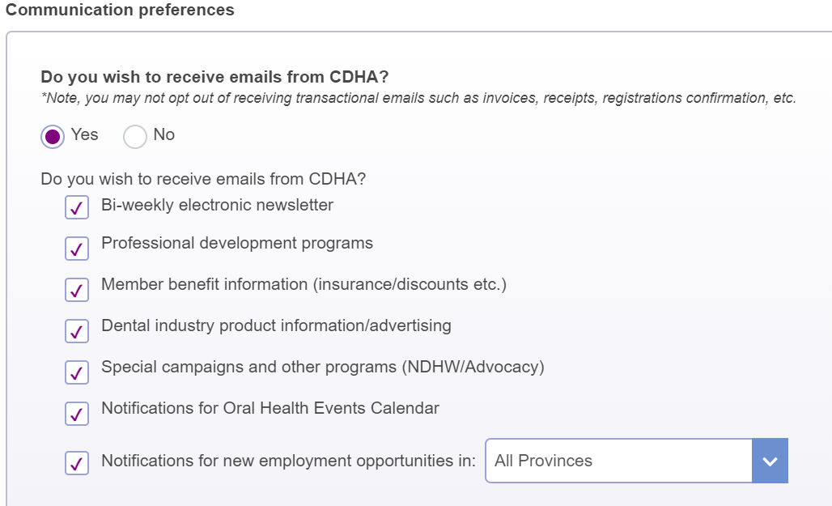
Weekly Alerts
Notes:
To activate the weekly alert, edit the communication preferences in your online profile and check the "Notifications for new employment opportunities" box. You can specify a specific province/territory or select “All Provinces.”

Slide 49
Applying for a Position
Résumé
List skills, experience, abilities
Format, editing, and design
Cover Letter
Customize
Research employer
Format, editing, and design
Notes:
When you’re ready to apply for a position, you will need to provide a résumé and cover letter.
This slide quickly lists what elements should be included along with other items to keep in mind.
More detailed information can be found on CDHA’s website.

Slide 50
The Interview
Preparation
Research
Practice
Presentation
Dress professionally, conservatively
Fit
Position/office right fit?
Ask questions
cdha.ca/careers
Notes:
After you’ve landed an interview with your stellar résumé and cover letter, use the interview as an opportunity to show the employer your interest in the position and, in turn, the energy and expertise you will bring to the job. Remember to do your homework on the office. Check out their website and social media pages to get an idea of what they value at the office.
Getting to this stage shows that the employer has deemed you as qualified for consideration, and the interview is your chance to show that you will put that qualification to good use.

Slide 51
The Interview
Communication and etiquette
Good communication skills
Listen carefully, answer thoughtfully
Concluding the interview
Thank interviewer
Next steps
Working interviews
Notes:
While at the interview and when the interview concludes, there are a number of items to do or keep in mind and a short list is included here. More items are on the CDHA website.
Remember that the interview is a chance for you to also see if the office is the right fit for you. Ask how long the appointments are for an adult; if they say 40 minutes take that as a sign to move on. Ask if they have a mentoring program in place for you as a new grad or provide extended appointment times as you adjust to your new work life. Ask how long the staff have been there; if staff have only been there a short time, it could be a sign that the office may not treat their staff well and staff don’t stay. Ask if dental hygienists are paid for cancellations. Ask if they have a stericentre manual that is compliant with IPAC protocols for both dental and dental hygiene regulatory bodies.
If you’re interested in the position, send an email the next day to thank them for their time and that you look forward to hearing from them. It shows your professionalism and reminds them of who you are. Especially if they’ve interviewed several other dental hygienists for the position.
Working interviews are sometimes used for dental hygiene positions. The office will have you work a half or full day to see your interaction with clients, and assess your skills. If your interview falls into this category, don't be more stressed because of it, think of it as a first day on the job with no obligations. But keep in mind that the prospective employer should pay you. Make sure you confirm beforehand that you will be paid. If they decline, take this as a sign that this is not the office for you. Recently a dental hygienist in the Ottawa area had a working interview for half a day and when she asked to be paid, both the office manager and dentist said they don’t pay for working interviews. She went to the Labour Board of Ontario and lodged a complaint. It took a while but she was indeed paid for that time. And again, working interviews are an opportunity for you to see how the office flows. Are staff stressed, are they kind and help one another, is there laughter? You should enjoy your workplace.

Slide 52
Contracts
Self-employed vs. employee status
Contract wording
Determines if Revenue Canada decides you are employee vs. independent contractor
Sample contracts
Notes:
When you decide to commit to a position, ensure that there is an appropriate written contract in place. Having a written employment contract allows both you and your employer to have a clear understanding of the expectations that you have of each other. Understanding the difference between self-employment and employee status is extremely important when setting up your relationship with your employer and in the creation of your contract. Just because an employer wants to hire a dental hygienist as an independent contractor, does not mean that the job meets the criteria of being deemed an independent contractor by CRA.
Two of the biggest criteria of being an independent contractor are that you supply up own instruments and that you set your own schedule. You decide when you will work, how long your client appointments are, when you will take vacation.
In the Career Centre section of CDHA’s website, there’s a sub-section that outlines the differences and advantages and disadvantages of between being self-employed and being an employee.
When you receive a contract, your potential employer has to give you adequate time to fully review it. It is also recommended that you have a legal professional review the contract.

Slide 53
Contracts
Notes:
There are advantages and disadvantages of being self-employed. If you’re being offered an independent contractor position, please make sure you review CDHA’s Self-Employed vs. Employee Status page under the Career menu.
CDHA also has the resource Negotiating a Service Agreement as an Independent Contractor in the Contracts and Policies section of Healthy and Respectful Workplace as well as a short video that answers, “What are the Legal Considerations for Hiring an RDH as an Employee or a Contractor?”
(Optional to play the video) Let’s watch the short video now.
(Note to presenter, link is https://vimeo.com/538177015)

Slide 54
Employment Legal Line
cdha.ca/employmentlaw
Notes:
Just because you have been presented with a contract, it does not mean that you have to sign it. The contents of a contract can be negotiated and it’s always advised to have a lawyer review a contract before you sign it. CDHA offers practising and support members access to a free Employment Legal Line to get advice on employment matters including regulatory law.

Slide 55
Social Media Webinar
cdha.ca/webinars
Notes:
Let’s turn our attention to social media for a moment. Most, if not all of you, use social media. As you enter the profession, you may decide to utilize the power of social media to become an influential voice of your new profession.
CDHA invites you to watch a webinar about social media engagement. This session examines the far-reaching impact of social media and how it can be harnessed. By examining the rules of engagement, you will learn the dos and don’ts of social media for health care professionals, including code of conduct, privacy considerations, and professional responsibilities. The webinar will also feature specific examples, tips, and tools, and will also highlight best practices for success.

Slide 56
Independent Practice
Notes:
Now let’s briefly talk about independent practising dental hygienists. How many here have thought about opening their own dental hygiene business? This segment of the profession is growing really fast.
RDH’s may provide oral health care in settings other than a traditional dental office. They may choose to have their own brick and mortar office; or operate a mobile practice where they travel to their client's place of residence or a long-term care facility; or open a home-based business. They have the freedom to make their own decisions regarding the care they provide and offer clients a wider range of choices. They make a difference every day and play an important role in improving access to dental hygiene care for Canadians.
Support for independent practitioners is a high priority for CDHA. They offer the Independent Practice Network which is designed to meet the specific needs of this growing community. An IPN member has access to business courses to get started or grow their business—and I’ll talk about those briefly in a moment. An IPN member also has access to an online community to provide support or get support from other independent practitioners, and an online marketplace where equipment can be posted for sale.

Slide 57
Independent Practice
Notes:
If you’re interested in independent dental hygiene, you may want to take a look at CDHA’s Spotlight on Independent Dental Hygiene Practice resource. It provides some great information on the different ways and the different communities independent dental hygienists provide oral health care.

Slide 58
Independent Practice
Notes:
For those of you who are entrepreneurs, CDHA also offers a business course designed set you on the path of successful business ownership. This course guides you through assessing your entrepreneurial skills, developing a business plan, assessing the feasibility of your business, guidelines on marketing, operations and financing. This course should be the first step you take when opening a business.

Slide 59
Independent Practice
Notes:
CDHA recently released another independent practice online course that provides guidance to current dental hygiene business owners on how to grow or evolve their business.

Slide 60
Independent Practice
Clayton De Corte, RDH Professional Practice Advisor
Notes:
Clayton De Corte is CDHA’s professional practice advisor. His focus is providing mentorship and guidance to those who are considering opening an independently owned dental hygiene business or to those currently operating or are contemplating selling their own independent practice. Clayton has been in the dental hygiene profession for 23 years and owned and operated his own dental hygiene business in downtown Toronto before selling it. He’s also available to answer general dental hygiene practice questions.

Slide 61
Independent Practice Network
PROVINCE | # | PROVINCE | #
Alberta | 249 | Nova Scotia | 25
British Columbia | 159 | Ontario | 945
Manitoba | 13 | Québec | 121
Newfoundland & Labrador | 29 | Saskatchewan | 21
New Brunswick | 35 | PEI | 5
*The North does not currently allow dental hygienists to work as independent practitioners.
Notes:
There are more than 1,600 dental hygienists registered in CDHA’s Independent Practice Network and here are the numbers by province. Note that The North does not currently allow dental hygienists to work as independent practitioners.
A few years ago, Quebec’s National Assembly unanimously passed a law allowing dental hygienists to practise independently, without supervision from a dentist. This was a historic moment for the dental hygiene profession in Quebec and cause for celebration across Canada as we moved one step closer to accessible oral health care for all. So the numbers in Quebec will keep growing.
In 2023, dental hygienists in PEI were awarded self-regulation status. They set up their own regulatory body and established protocols and processes for the profession. This self-regulation also authorizes dental hygienists in PEI to practice independently of a dentist, increasing access to care.

Slide 62
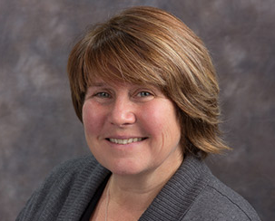
Staff: At Your Service
Notes:
CDHA is managed by a staff at the national office in Ottawa and are there to assist you with a variety of dental hygiene or membership inquiries or with any other related questions you may have.
Contact them by phone, email, or social media.

Slide 63
Connect with CDHA
.com/theCDHA
Request to join today!
.com/theCDHA
.com/groups/CDHAdentalhygienists
.com/theCDHA
Notes:
CDHA wants to make sure you have the opportunity to connect and share with CDHA and each other on various online and social media platforms.
Request to join the Facebook group today! If you search for it, you’ll find it under “CDHA & Dental Hygiene News”

Slide 64
CDHA Membership
cdha.ca/join 1-800-267-5235
Notes:
So that is what CDHA membership can do for you in a nutshell. Only current Student members will be eligible for FREE Graduated membership upon successful completion of the board exam.
If you haven’t joined CDHA, you still have time. Plus, signing up is fast and free!

Slide 65
Notes:
Congratulations on your choice of an exciting career in dental hygiene! Join the CDHA community and let your voice be heard.

Slide 66
QUIZ TIME!
Prize at stake
Notes:
It’s time for the final quiz question and last prize giveaway! If you think you know the answer, please use the chat feature.

Slide 67
Quiz Question
What CDHA membership benefit most excites you?
CDHA Perks: Perkopolis / ESM
Professional Development
Counselling
Employment Line
Liability Insurance
Publications
Career Centre
FREE Webinars
GoodLife Fitness
… and more!
Notes:
Final quiz question: What membership benefit most excites you?
Congrats to [ name here ]. They correctly stated a current membership benefit!
And the answer is that… There are a number of membership benefits available to you that should excite you! Some are listed here and there’s more on CDHA’s website.

Slide 68
Questions?
Notes:
Thank you for your time. Do you have any questions?

