Slide 1
Notes:
Congratulations on choosing a rewarding career!
Hi, I’m (name and background)
This presentation will introduce you to the Canadian Dental Hygienists Association, also referred to as CDHA, and let you know how membership can make the career you are about to begin even more rewarding.
To help you prepare for your career, you will require support and access to resources and professional development opportunities. This is where CDHA can help!

Slide 2
It’s FREE!
Student Membership
Join today at
cdha.ca/join
Notes:
CDHA membership is FREE for students so take a minute and join online today.

Slide 3
President’s Message
Notes:
Let’s view this video greeting from CDHA president Anne Caissie from New Brunswick.
https://youtu.be/-wbhHL7RsXY

Slide 4
CDHA’s Mission
Notes:
So let’s talk a bit about why CDHA exists. Does anyone know what CDHA’s mission is?
(Hint) Are they the voice of the public? Or the voice of dental hygienists?

Slide 5
Notes:
CDHA is the collective, national voice of more than 31,000 dental hygienists working in Canada, and they directly represent more than 21,000 members including students.
The primary role or mandate of CDHA is to advance the dental hygiene profession, support its members, and contribute to the oral health and the general well-being of all persons living in Canada.

Slide 6
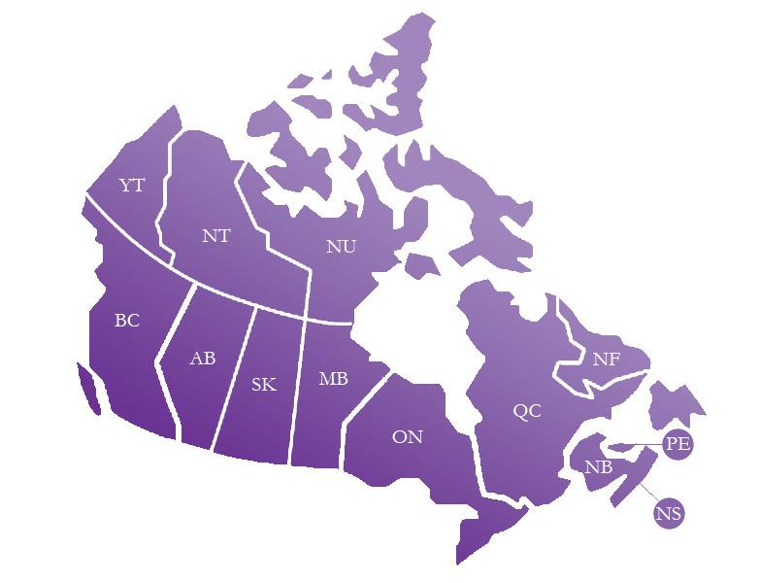
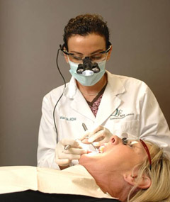
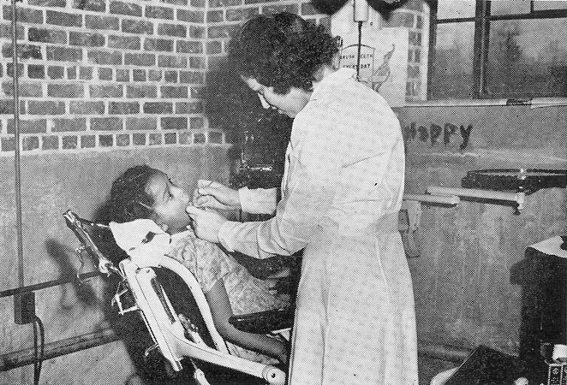
History of Dental Hygiene
Province/Territory | Year
Ontario | 1947
Saskatchewan | 1948
Prince Edward Island | 1950
Alberta | 1951
British Columbia | 1951
Manitoba | 1952
New Brunswick | 1953
Nova Scotia | 1955
Yukon | 1958
Québec | 1962
Northwest Territories | 1967
Newfoundland & Labrador | 1968
Notes:
Let’s take a look at the historical background of legal recognition of dental hygiene in Canada:
In 1947, dental hygiene was recognized as a health occupation in Ontario.
In 1963, the Canadian Dental Hygienists Association was formed.
In the mid-1970s and particularly from the early 1990s to date, dental hygiene gradually achieved self-regulation and professional status.
Today, dental hygienists can practise independently and without supervision in all areas except PEI and The North.

Slide 7
Board: At Your Service
Notes:
CDHA is directed by a board of dental hygienists who represent the 10 provinces and the North.
Board and staff focus on five broad areas:
Professional Knowledge
Public Policy Environment
Professional Practice – which includes Healthier and More Respectful Workplace and Pandemic Response
Public Recognition and
Leadership

Slide 8
Staff: At Your Service
Notes:
CDHA is managed by a staff at the national office in Ottawa.
CDHA board and staff members are here to serve you. Consult the CDHA website and contact them by phone, email, or social media.

Slide 9
Dental Hygiene Organizations
National Organizations
Provincial Regulatory Authorities
Professional Associations
Provincial Organizations
Notes:
There are several key organizations in the profession. Each organization has different roles and responsibilities. It’s important to understand each of these organizations and the role they will play in your career as a dental hygienist. Let’s take a look at how each organization functions within the profession.

Slide 10
National Organizations
Commission on Dental Accreditation of Canada (CDAC)
Federation of Dental Hygiene Regulators of Canada (FDHRC)
Notes:
The national organizations associated with dental hygiene include:
The Commission on Dental Accreditation of Canada. CDAC’s primary role is to assess and evaluate dental hygiene programs across Canada in order to ensure they meet national dental hygiene educational standards.
And the Federation of Dental Hygiene Regulators of Canada. This organization gathers all of the provincial regulatory bodies across Canada. Their mission is to provide national leadership in dental hygiene regulation for the protection of the public.
And, if you hadn’t heard, the Federation amalgamated with the National Dental Hygiene Certification Board, which develops and administers the board exam. They are now a single entity operating under FDHRC and have a new consolidated website to provide candidates, instructors, and stakeholders with “one place to look” for information on all Federation programs and activities.

Slide 11
Provincial Regulatory Authorities
Department of Community Services, Government of Yukon
Department of Health and Social Services, Government of Nunavut
Notes:
Provincial organizations include the provincial dental hygiene regulatory authorities, which regulate the profession of dental hygiene and register dental hygienists who have met eligibility criteria in their province or territory. The regulatory authorities’ main interest is the overall health and safety of the public.
In order to practise in Canada, dental hygienists must be registered or licensed by the appropriate provincial or territorial dental hygiene regulatory authority. Requirements for registration or licensure and scope of practice vary by province or territory.

Slide 12
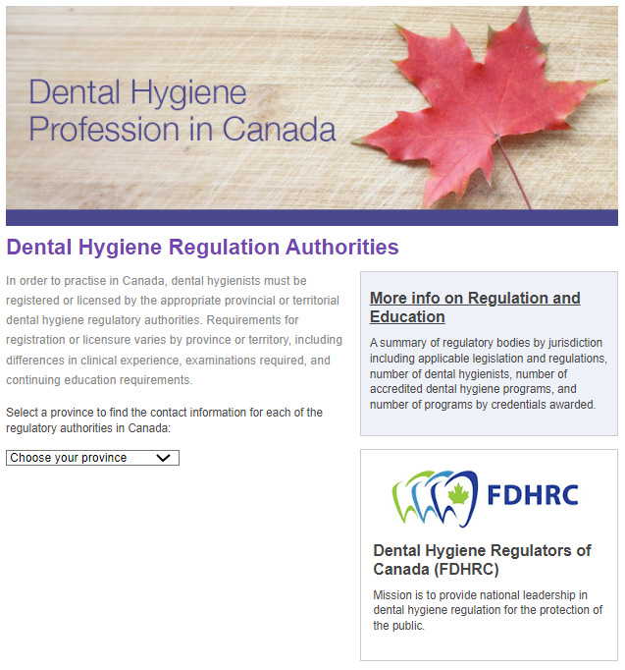
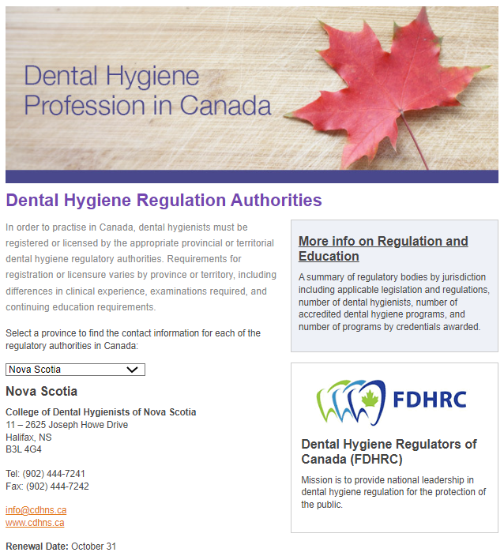
Provincial Regulatory Authorities
Notes:
For additional details, including contact information for each provincial regulatory body, visit CDHA’s website under the “Career Centre” menu.
In the screen capture on the left, this is the regulatory authority main page. Simply select the province or territory you want from the drop-down list.
Once you’ve made your selection, you’ll then see the details of the corresponding regulatory authority. In the example on the right, Nova Scotia was selected.

Slide 13
Professional Associations
Local
Provincial
National: CDHA
International: IFDH
Notes:
Dental hygiene professional associations exist to advance the profession and advocate on behalf of their members, dental hygienists, and students. There are different levels of professional associations. For example:
Local associations or societies represent dental hygienists in their immediate communities.
Provincial associations represent dental hygienists on a provincial level. The needs of dental hygienists may vary somewhat from one province/territory to another.
CDHA is the national association advocating on behalf of dental hygienists in Canada regarding issues that affect the profession overall.
The International Federation of Dental Hygienists (IFDH) unites dental hygienists in 23 countries around the world with the goal of promoting global oral health.

Slide 14
Professional Associations
Notes:
In August 2022 during the International Symposium of Dental Hygiene, CDHA member Wanda Fedora from Nova Scotia was officially installed as president of IFDH.

Slide 15
Provincial Organizations
*SDHA is also the regulatory authority.
Notes:
Provincial organizations advocate on behalf of their members, dental hygienists, and students on issues specific to the regulations, scope of duties, and range of services performed by dental hygienists in their particular province.

Slide 16
Provincial Organizations
Notes:
For the complete list of provincial organizations visit the Community section of CDHA’s website.
CDHA encourages you to join your national, provincial and local organizations as they all complement each other.

Slide 17
QUIZ TIME!
Prize at stake
Notes:
At this time, I’d like to ask a quiz question and a prize will be awarded for the correct answer. If you think you know the answer, please [insert how here]. The question will appear on the next slide so pay attention!

Slide 18
Quiz Question
True or False?
CDHA student membership costs $100.
FALSE: Joining CDHA as a student member is FREE!
Notes:
TRUE or FALSE? CDHA student membership costs $100.
And the answer is:
FALSE. Joining CDHA is free for students!

Slide 19
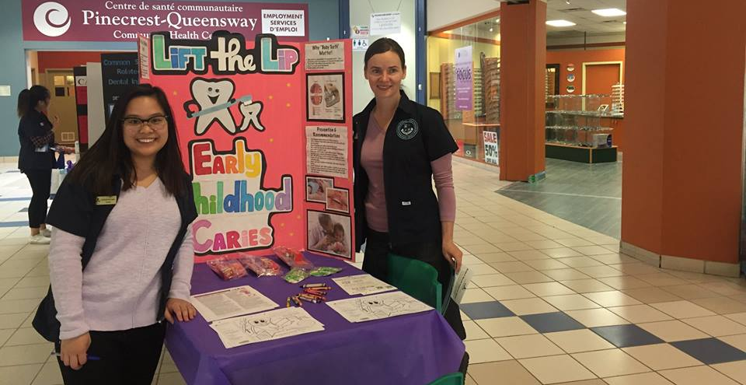
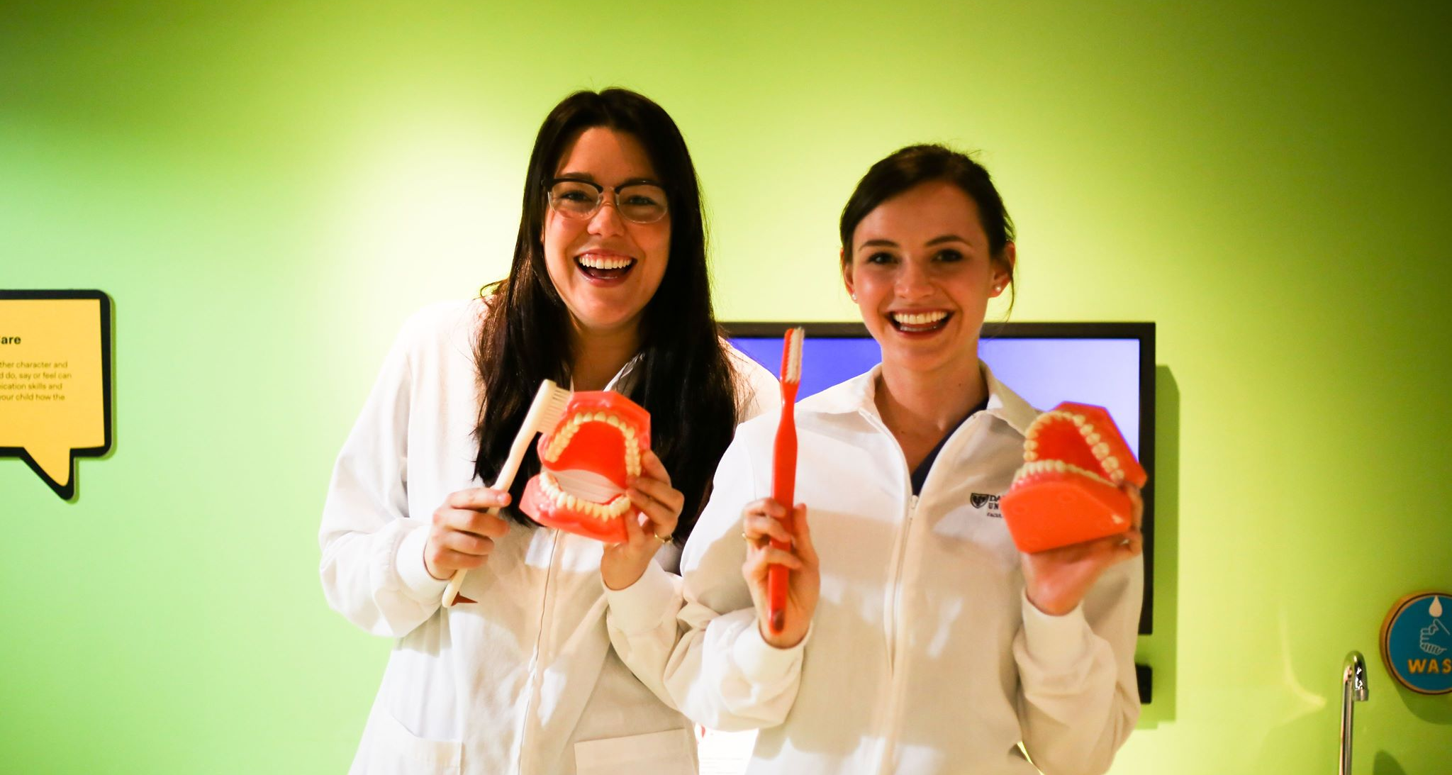
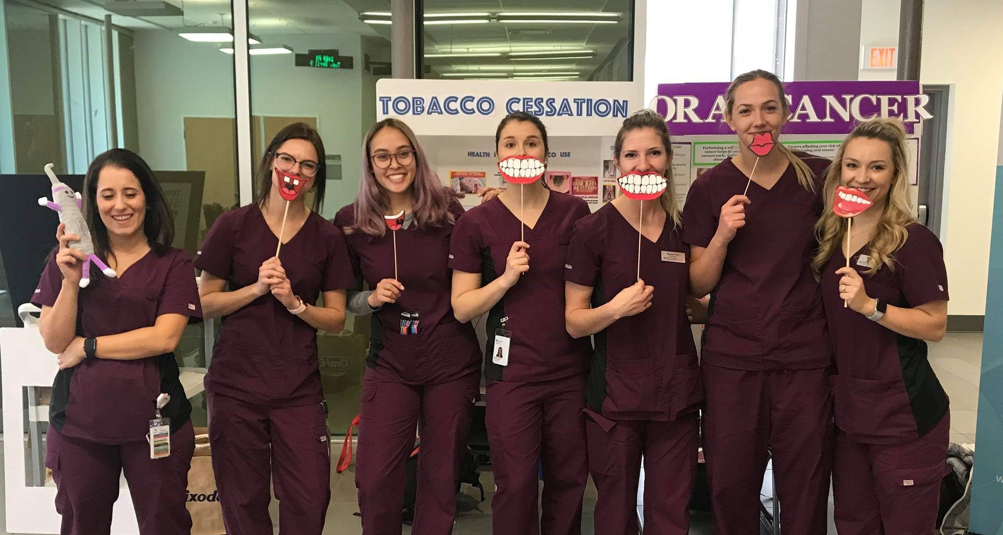
Why Join CDHA?
Benefits & discounts
Student initiatives
Events
Resources
Professional development
… and more!
Notes:
Why join CDHA?
As a Student Member, you have access to member benefits and discounts, a student leadership program and student writing competitions, networking and events, professional development, and resources to help you get started in your career.

Slide 20
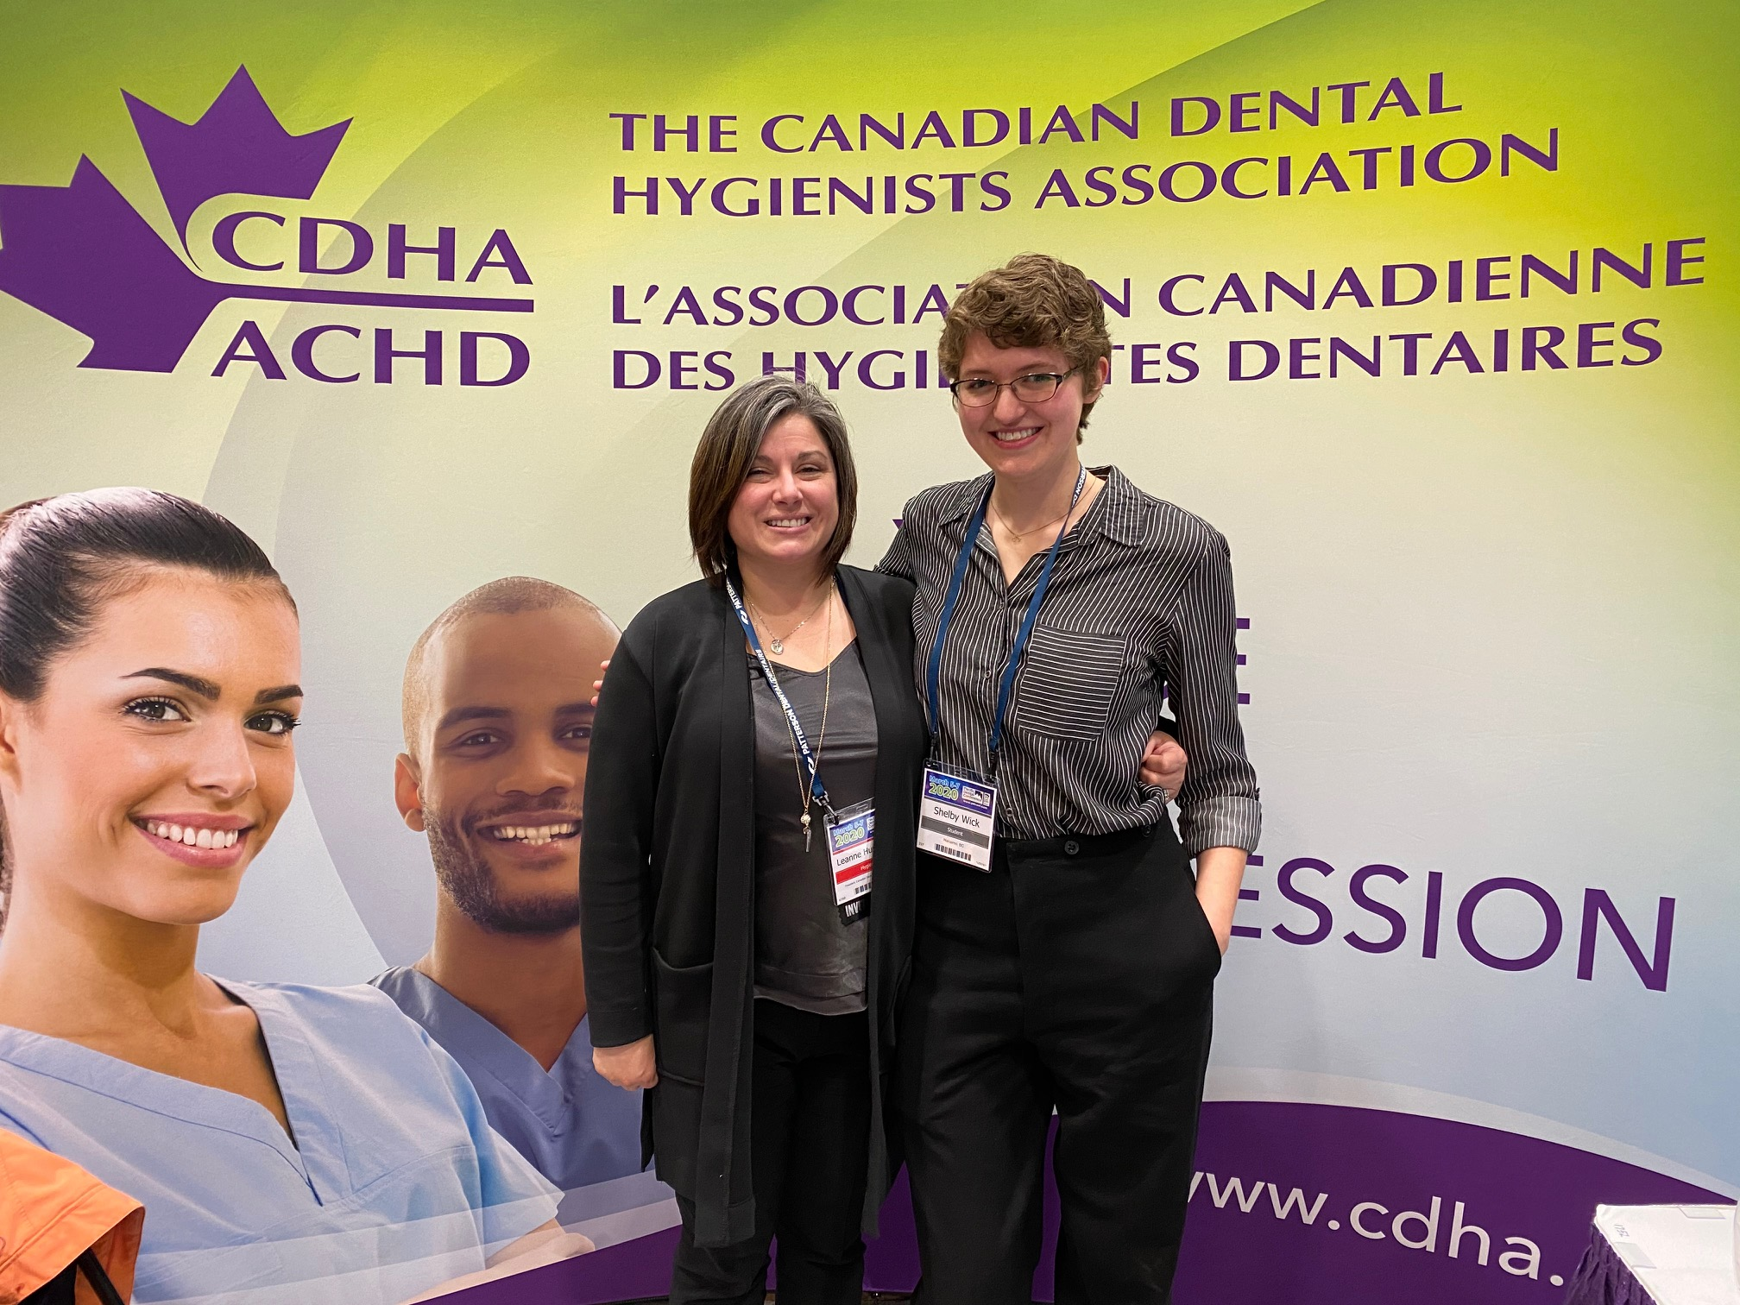
Student Leadership Program
Develop leadership skills
Make connections
Enhance career
Help shape future of the profession
Junior position & recruitment
Bursary from
Notes:
One of the benefits of being a student member is that you can be part of the CDHA student leadership program.
CDHA student leaders serve as the primary liaison between CDHA and faculty and students, promoting membership, programs, and services. Each fall, a Junior Student Leader is selected to assist the Senior Student Leader. In the case of accelerated programs, the timing may be different so please visit CDHA’s website for details.
Through a partnership with Colgate, a bursary is provided.

Slide 21
Student Leadership Program
Notes:
Becoming a student leader allows you to develop your leadership skills and connect with your association, your faculty, and peers. Find out who your Senior Student Representative is and consider running for the junior position or visit cdha.ca/StudentLeader.
Let’s find out more about the program from a current student leader.
(Note to presenter, link is https://youtu.be/xwmStQfew9s)

Slide 22
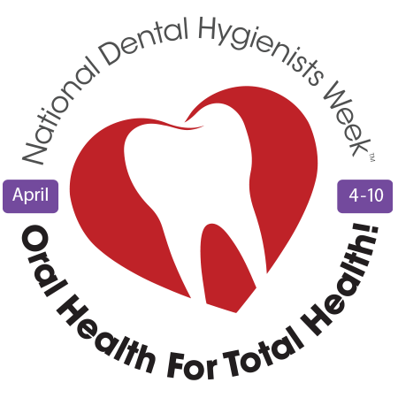
Networking & Events
National Dental Hygienists Week™ April 4–10
Oral Health Month: April
Notes:
CDHA events that you can get involved in as a student or when you’re practising include:
National Dental Hygienists Week – this national event is held annually in April and is dedicated to increasing public awareness of the importance of oral health and the role of dental hygienists. NDHW takes place during Oral Health Month.

Slide 23
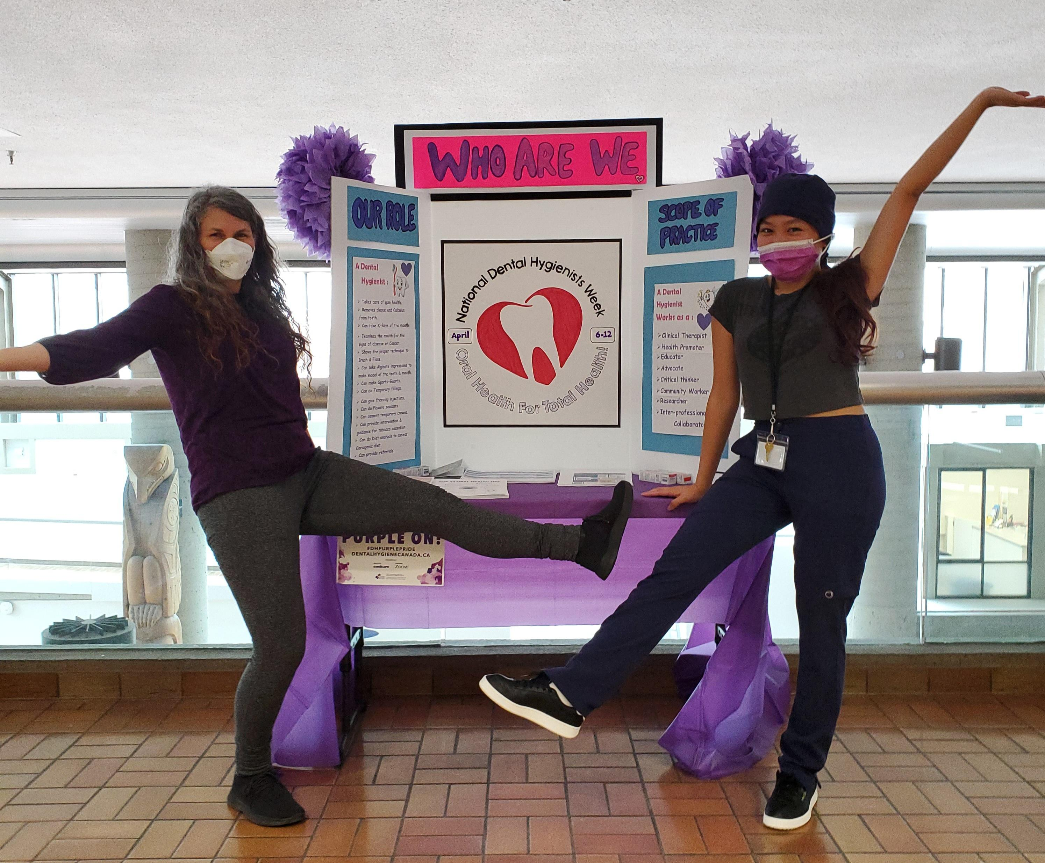
#NDHW Spirit
Notes:
Here are some photos submitted by students celebrating National Dental Hygienists Week. Maybe these images will inspire you to get involved!

Slide 24
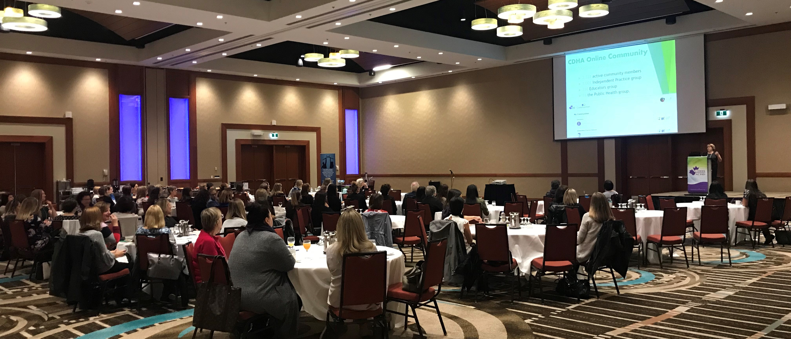
Networking & Events
Provincial events
CDHA Summit
CDHA National Conference
Notes:
Watch for CDHA at provincial meetings and dental conferences like the PDC and ODA. The pandemic is continuing to change the landscape for in-person events, but CDHA is planning to attend events in person.
Community-awareness events – CDHA also supports events that help promote oral health in the community and raise awareness of the profession.
A summit and national conference – CDHA holds a summit and a national conference on alternating years. The summit focuses on leadership and also has a professional development component. The conference explores the latest issues, trends, and research impacting dental hygiene practice in Canada.

Slide 25
Notes:
As mentioned previously, CDHA hosts a summit every other year. The next one is in Winnipeg in October 2023, and it will focus on diversity, equity and inclusion.

Slide 26
Notes:
And CDHA’s next national conference is in Niagara Falls in October 2024. These conferences offer a chance for you to build relationships with like-minded dental hygiene professionals from across the country. They are also a great place to connect, discuss, and engage with presenters for a richer, more meaningful learning experience. Plus, they’re just a lot of fun!

Slide 27
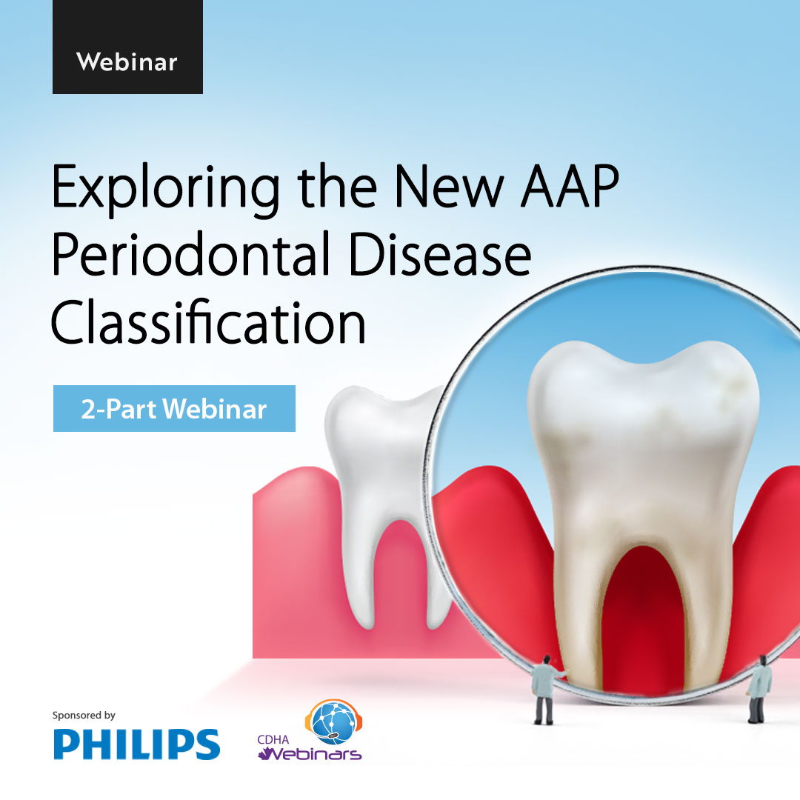
Professional Development
All webinars are FREE
Courses
Workshops
Notes:
CDHA also offers many professional development opportunities in the form of webinars, courses, and workshops on a variety of dental hygiene topics. Most opportunities are available to students at a discount or are free.
To view the complete online library, visit CDHA’s website.

Slide 28
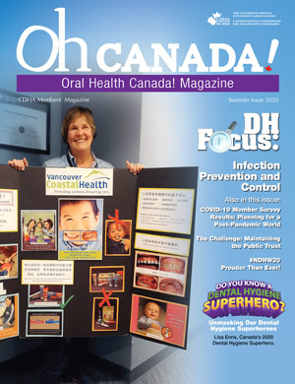
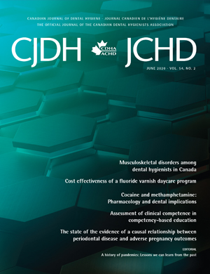
Resources
Notes:
CDHA offers a wide variety of publication resources for members including:
Oh Canada! member magazine
The scientific publication Canadian Journal of Dental Hygiene (CJDH)
eNewsletters issued twice monthly
Clinical practice guidelines
Evidence-based position papers and statements
And more!

Slide 29
Membership Means More
Notes:
Here’s a snapshot of the learning opportunities available to you, most of which were just mentioned.
(Note to presenter: link is https://youtu.be/W7T2HgU7RWg)

Slide 30
Notes:
Colgate is proud to share some resources that will be helpful as you begin your new life as a dental hygiene student. As you start your first semester, family and friends will come to you for advice in oral health and Colgate has 2 websites that will be helpful throughout your journey.

Slide 31
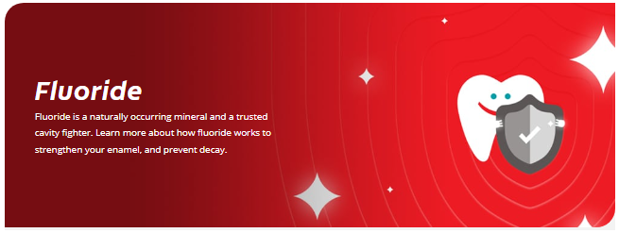
Patient Advice
Colgate.com/en-ca
Teeth Whitening
Gum Disease
Mouth Sores & Infections
Dry Mouth
Nutrition & Oral Health
Adult Oral Care
X-Rays
Notes:
On Colgate’s 1st website, you’ll find articles to educate your patients on oral health/how to keep a healthy smile. You’ll also find answers to the most common questions about teeth whitening, gum disease, dry mouth, and more.

Slide 32
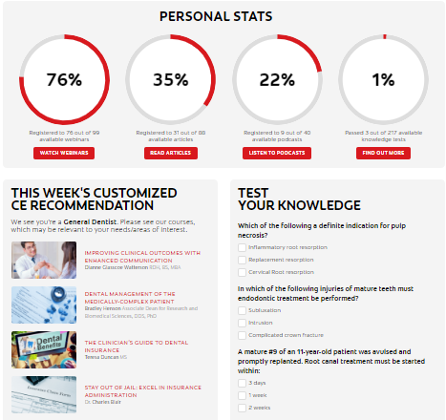
Colgate Oral Health Network
Notes:
On Colgate’s 2nd website, you’ll find live webinars, podcasts, and the latest oral health news to stay on top of what’s going on in the dental world. You can also use this site as a personal coach where you will monitor your progress and test your knowledge on various dental hygiene topics.
I would like to invite you to create a dental hygiene student account and watch a webinar I picked just for you: _______________________________
Note to presenter:
Find one webinar/podcast suitable for 1st year students and invite them to watch/listen.

Slide 33
Whole Mouth Health
Reduces bacteria on teeth, tongue, cheeks and gums
Helps prevent cavities
Reduces sensitivity discomfort
Reduces tartar formation
Enamel strengthening
Helps prevent gum problems caused by bacteria
Notes:
You’ll also each receive Colgate samples. Colgate encourages you to try this toothpaste today!
Note to presenter:
Read benefits
Say something about how Colgate Total works and why they should use it

Slide 34
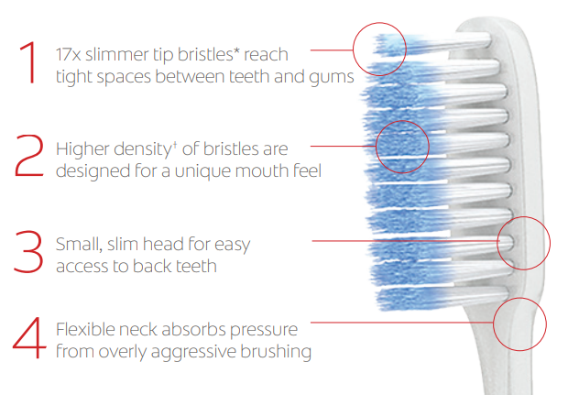
Slim Soft Ultra Soft
Notes:
Colgate also encourages you to try the new Slim Soft Ultra Soft toothbrush.
Note to presenter:
Read benefits
In your own words, explain why they should try it and use it

Slide 35
QUIZ TIME!
Prize at stake
Notes:
I have another quiz question and a prize to give away for the correct answer. If you think you know the answer, please [insert how here]

Slide 36
Quiz Question
In which month does National Dental Hygienists Week™ occur?
APRIL: April 4–10 cdha.ca/NDHW
Notes:
In which month does National Dental Hygienists Week occur?
And the answer is:
NDHW takes place in APRIL. For all things NDHW-related, visit CDHA’s website.

Slide 37
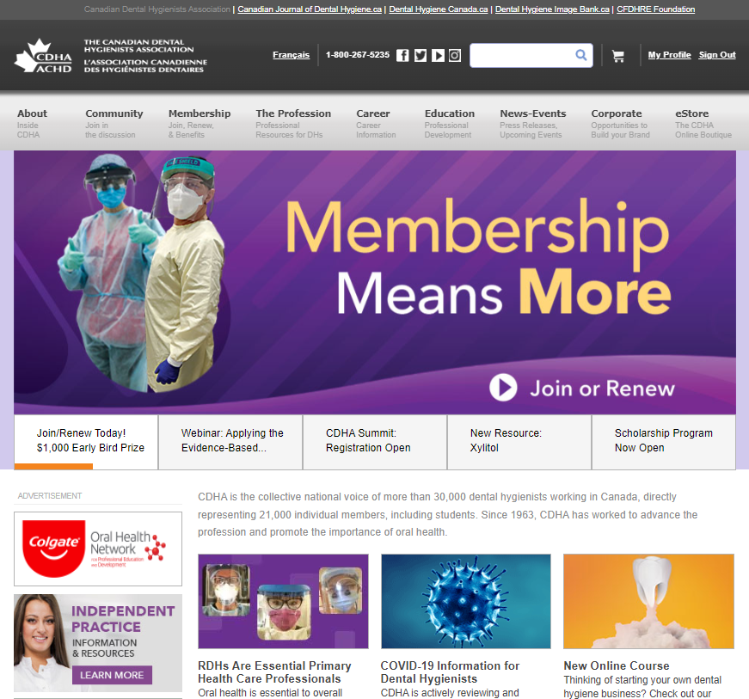
cdha.ca
Your primary source of information
Notes:
The CDHA website is your primary source of information and it’s mobile friendly!

Slide 38
cdha.ca/careercentre
Notes:
Let’s look at some other reasons to be part of CDHA.
On the website, you can navigate to the career centre which is a great place for soon-to-be grads to look for career opportunities. It’s the most popular content page and is available for members only. And it has been revamped in early 2023 where you can:
Search the latest employment opportunities, now by city or province;
Find out about salaries in your area;
Learn about healthy and respectful workplaces;
Access resources to help build your career; and more!
With new postings almost daily, the Career Centre is the perfect platform for connecting with recruiters looking for your specialized skill set.

Slide 39
Career Centre
Notes:
You can even sign up for weekly career alerts delivered to your inbox each week!

Slide 40
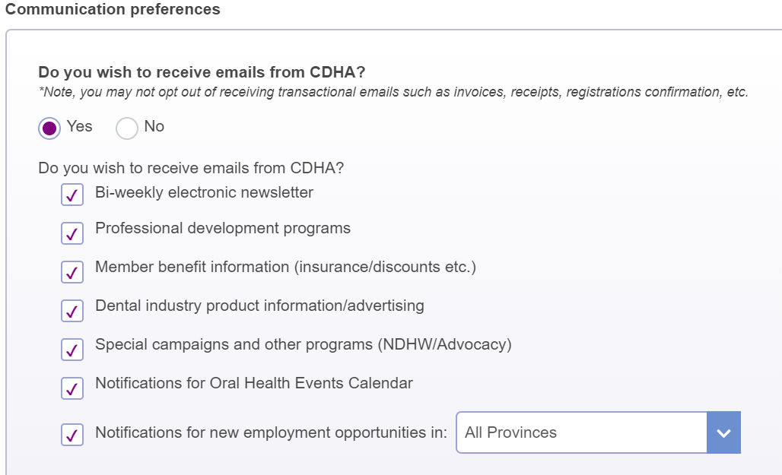
Weekly Alerts
Notes:
Log into your online profile and check the appropriate communications box. You can then specify a specific province/territory or select “All Provinces.”

Slide 41
dentalhygienecanada.ca
Notes:
Additional resources can be found on CDHA’s bilingual consumer website at dentalhygienecanada.ca. You’ll find all kinds of educational oral health information for clients of all ages. Resources on fluoride, toothbrushing, and diabetes were recently added, and you can also check out resources on vaping, sugar, and tobacco.
Once you start client care clinics, the resources on dental hygiene Canada can be great handouts to give to clients to reinforce the education you’ve provided. A link to Dental Hygiene Canada can be found on the CDHA website at the top of the page.

Slide 42
Discounts
CDHA Perks: Perkopolis & ESM
Notes:
CDHA is thrilled to continue bringing you savings on movies, events, shopping, dining, and more… through Perkopolis and Endless Savings & More!
Visit CDHA’s website to register for both discount programs and download their mobile apps.
Let’s watch a quick video about one of them. [ https://youtu.be/giU8vR_hXjM ]

Slide 43
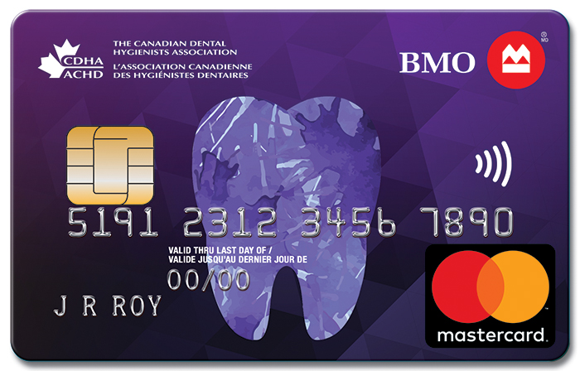
Discounts
GoodLife Fitness
Worldwide Hotel
Car Rental
Loupes
… and more!
Notes:
CDHA is constantly striving to enhance the value of your membership. The association is pleased to offer a number of discount programs including:
GoodLife Fitness – which offers preferred membership pricing with access to over 200 clubs across Canada
A worldwide inventory of hotels at unbeatable rates
And more!
If you have any new ideas for benefits, please let CDHA know!

Slide 44
Insurance Programs: Current
Notes:
As a CDHA student member, you also have access to:
Savings on your home and auto insurance with preferred group rates and financial advisor services
and
Personal insurance programs

Slide 45
Insurance Programs: Future
Notes:
Once you’ve graduated and entered the workforce, CDHA has a variety of additional benefits including:
Professional liability insurance
Clinic business insurance
For more information on all member benefits, visit CDHA’s website.

Slide 46
FREE Graduated Student Membership
After Graduation
includes
Notes:
After graduating from your dental hygiene program and successfully completing the National Dental Hygiene Certification Board Exam, you can upgrade your CDHA Student membership to Graduated Student membership.
Membership is still FREE and now it includes professional liability insurance coverage. Professional liability insurance is required in order to practice in the profession.

Slide 47
Contact CDHA
cdha.ca
info@cdha.ca
1-800-267-5235
Notes:
CDHA staff members are available to assist you with a variety of dental hygiene or membership inquiries or with any other related questions you may have.
Contact them:
By visiting the CDHA website;
By email; or
Via telephone

Slide 48
Connect with CDHA
.com/theCDHA
.com/theCDHA
Request to join today!
.com/groups/CDHAstudents
.com/groups/CDHAdentalhygienists
.com/theCDHA
Notes:
CDHA wants to make sure you have the opportunity to connect and share with CDHA and each other on various online and social media platforms including a special student Facebook group. Request to join this group today!
CDHA hosts a weekly #TriviaTuesday question so check it out and test your knowledge each week on a variety of topics.

Slide 49
It’s Your Turn
cdha.ca/join 1-800-267-5235
Notes:
Joining CDHA is easy and it’s FREE. Visit cdha.ca/join and select the Student Membership icon. And once you’ve joined, you can start and then easily continue accessing your membership benefits with CDHA’s new student autorenewal feature. This means your student membership will be automatically renewed each year until your graduation.

Slide 50
QUIZ TIME!
Prize at stake
Notes:
Final quiz question! Get ready…

Slide 51
Quiz Question
What CDHA membership benefit most excites you?
CDHA Perks
Leadership Program
Professional Development
Liability Insurance
Publications
FREE Webinars
GoodLife Fitness
Career Centre
… and more!
Notes:
What membership benefit most excites you?
[NOTE TO PRESENTER – this is a trick question! Any CDHA member benefits that a student offers up is correct]
There are a number of CDHA membership benefits available to you! Some are listed here and there’s more information on CDHA’s website at cdha.ca/benefits.

Slide 52
Notes:
We hope this presentation has answered all of your questions about CDHA. Feel free to contact CDHA or your CDHA student leader if you have any other questions.
And finally, congratulations on your choice of an exciting career in dental hygiene! Join the CDHA community and let your voice be heard. Don’t forget: student membership is FREE!

