Slide 1
Notes:
Congratulations on your upcoming graduation!
This presentation will outline what lies ahead as you begin a rewarding career in dental hygiene. To help you prepare, you will require support and access to resources. This is where CDHA can help!

Slide 2
CDHA: Your National Association
Notes:
CDHA is the collective, national voice of more than 30,000 dental hygienists working in Canada, and we directly represent more than 21,000 members including 2,000 students. The primary role or mandate of the CDHA is to advance the dental hygiene profession, support its members, and contribute to the oral health and the general well-being of the public.

Slide 3
National Dental Hygienists Week™
Notes:
As the collective national voice, CDHA organizes an awareness campaign each April since it’s oral health month.
An important part of the celebration is National Dental Hygienists Week. This annual event focuses on the importance of maintaining good oral health practices and helping Canadians understand the role and importance of the dental hygiene profession.
Let’s queue up one of the national TV ads that ran in 2020.
[ TO PRESENTER: if you’re having issues, open a separate tab/window and share/play: https://youtu.be/ApsHzSOaHIY ]

Slide 4
Dental Hygiene Organizations
National Organizations
Provincial Regulatory Authorities
Professional Associations
Provincial Organizations
Notes:
Within the profession, there are several key organizations and each organization has different roles and responsibilities.
Let’s take a look at how each one functions within the profession.

Slide 5
National Organizations
Commission on Dental Accreditation of Canada (CDAC)
National Dental Hygiene Certification Board (NDHCB)
Federation of Dental Hygiene Regulators of Canada (FDHRC)
Notes:
The national organizations associated with the profession of dental hygiene include:
The Commission on Dental Accreditation of Canada. CDAC’s primary role is to assess and evaluate dental hygiene programs across Canada in order to ensure they meet national dental hygiene educational standards.
The National Dental Hygiene Certification Board. NDHCB develops and administers the national dental hygiene certification examination for graduates of dental hygiene programs. Otherwise known as the board exam! To help prepare you for the board exam, the NDHCB has 4 preparatory exams available for you. They will allow you to familiarize yourself with the software used and the format of the questions, so you feel more comfortable and confident during your actual exam.
And the Federation of Dental Hygiene Regulators of Canada. This organization gathers all of the provincial regulatory bodies across Canada. Their mission is to provide national leadership in dental hygiene regulation for the protection of the public.

Slide 6
Provincial Regulatory Authorities
College of Dental Hygienists of British Columbia (CDHBC)
College of Registered Dental Hygienists of Alberta (CRDHA)
Saskatchewan Dental Hygienists Association (SDHA)
College of Dental Hygienists of Manitoba (CDHM)
College of Dental Hygienists of Ontario (CDHO)
Ordre des hygiénistes dentaires du Québec (OHDQ)
New Brunswick College of Dental Hygienists (NBCDH)
College of Dental Hygienists of Nova Scotia (CDHNS)
Prince Edward Island Dental Council
Newfoundland and Labrador College of Dental Hygienists (NLCDH)
Department of Community Services, Government of Yukon
Department of Health and Social Services, Government of Northwest Territories
Department of Health and Social Services, Government of Nunavut
cdha.ca/regulatoryauthorities
Notes:
Provincial organizations include the provincial dental hygiene regulatory authorities, which regulate the profession of dental hygiene and register dental hygienists who have met eligibility criteria in their province or territory. The regulatory authorities’ main interest is the overall health and safety of the public. They’re there to ensure that dental hygienists who practice in their provinces follow the required processes and protocols and follow continuing education guidelines for that province.
In order to practise in Canada, dental hygienists must be registered or licensed by the appropriate provincial or territorial dental hygiene regulatory authority. Requirements for registration or licensure and scope of practice vary by province or territory. So please check with your province or territory’s regulatory authority regarding the steps to register for your license.
Contact information for each regulatory body is listed on the CDHA website. Let’s have a quick look at that page.

Slide 7
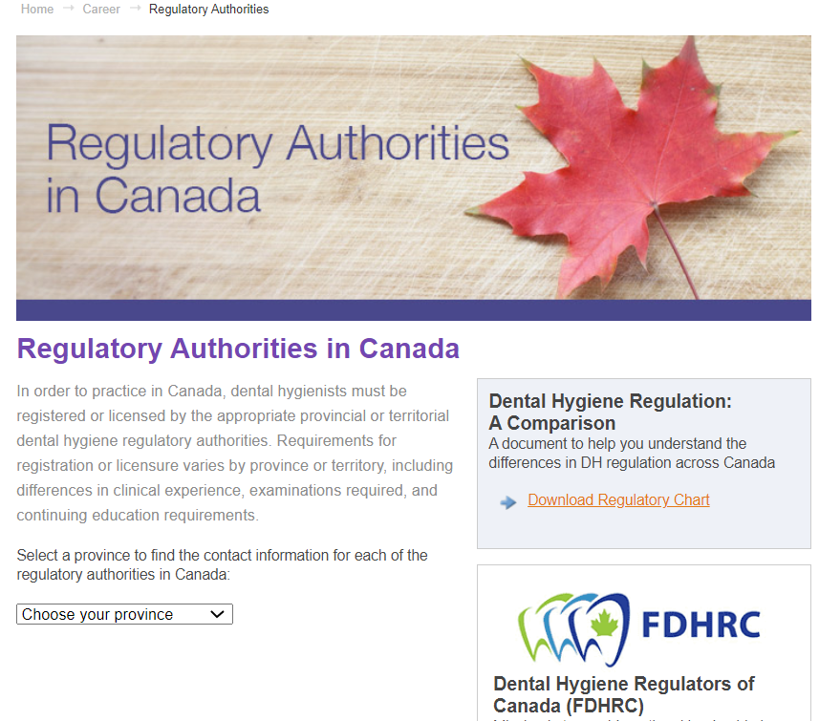
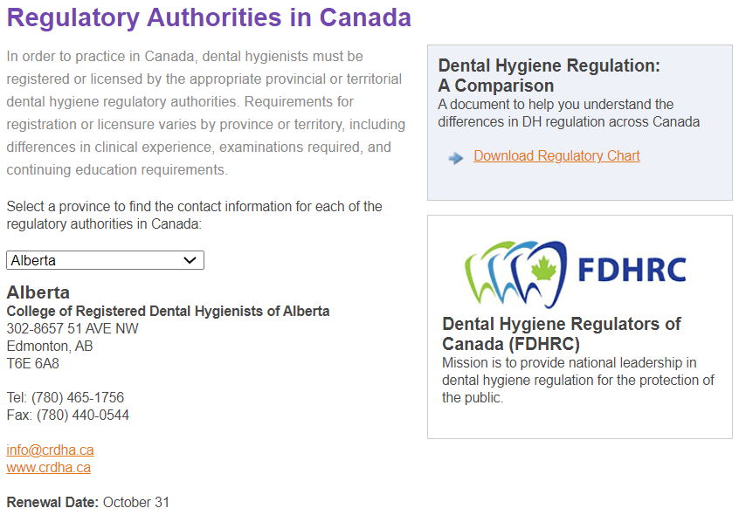
Provincial Regulatory Authorities
cdha.ca/regulatoryauthorities
Notes:
In the screen capture on the left, this is the regulatory authority main page on CDHA’s website. Simply select the province or territory you want from the drop-down list.
Once you’ve made your selection, you’ll then see the details of the corresponding regulatory authority. In our example on the right, we’ve selected Alberta.

Slide 8
Dental Hygiene Professional Associations
International: IFDH
National: CDHA
Provincial
Local
Notes:
Dental hygiene professional associations exist to advance the profession and advocate on behalf of their members, dental hygienists, and students. There are different levels of professional associations. For example:
The International Federation of Dental Hygienists (IFDH) unites dental hygienists in 23 countries around the world with the goal of promoting global oral health. We are very proud that the next president of the IFDH is CDHA member Wanda Fedora. The first Canadian to be elected as president since 1989. If you have any thoughts of travelling abroad to practice dental hygiene, check out their website.
CDHA is the national association advocating on behalf of dental hygienists in Canada regarding issues that affect the profession overall. Some of the current things we are advocating for at the national level are universal dental care, access to care for seniors, first nations and remote communities
Provincial organizations represent dental hygienists on a provincial level. The needs of dental hygienists may vary somewhat from one province/territory to another as they are regulated provincially.
Local associations or societies represent dental hygienists in their immediate communities. Your local associations are a great way to meet fellow DH’s in your community and support one another, get some continuing education credits and maybe do local oral health events together. Check your city to see if there is a local dental hygiene society.

Slide 9
Provincial Organizations
BC
British Columbia Dental Hygienists Association (BCDHA)
SK
PEI
Saskatchewan Dental Hygienists Association (SDHA)*
MB
Manitoba Dental Hygienists Association (MDHA)
Prince Edward Island Dental Hygienists Association (PEIDHA)
*These organizations are the regulatory authorities.
NL
QC
Fédération des hygiénistes dentaires du Québec (FHDQ)
Newfoundland and Labrador Dental Hygienists Association (NLDHA)
NB
College of Dental Hygienists of Nova Scotia (CDHNS)*
ON
Ontario Dental Hygienists Association (ODHA)
New Brunswick Dental Hygienists Association (NBDHA)
NS
Notes:
Provincial organizations advocate on behalf of their members, dental hygienists, and students on issues specific to the regulations, scope of duties, and range of services performed by dental hygienists in their particular province.
CDHA encourages you to join your national, provincial, and local associations as they all complement each other.

Slide 10
CDHA Membership
Notes:
So why should you be a part of CDHA? Let’s look at the top reasons in this video.
[ TO PRESENTER: if you’re having issues, open a separate tab/window and share/play: https://youtu.be/JJB4-AnivCk ]

Slide 11
FREE Graduated Student Membership
CDHA Membership
Includes Professional Liability Insurance
Upgrade at cdha.ca/studentupgrade
Registering in BC? Upgrade at cdhbc.com
Notes:
After successfully completing the National Dental Hygiene Board Exam, you can upgrade your CDHA Student membership to Graduated Student membership. Membership is still FREE and now it includes professional liability insurance coverage of up to $5 million aggregate until December 31st of that year. Professional liability insurance is required in order to practice in the profession. **If you’re registering in British Columbia, you will upgrade via the College of Dental Hygienists of British Columbia and your professional liability insurance is valid until the end of February.
Just to clarify, there is a difference between professional liability insurance and disability insurance. Professional liability insurance protects you against liability or allegations of liability for injury or damages that have resulted from a negligent act, error, omission, or malpractice that has arisen out of your professional capacity as a dental hygienist. Again, this type of insurance is included with your membership. Long-term disability insurance is available as an insurance add-on at an additional cost and it helps replace your lost income and helps protect your lifestyle if you are unable to work due to illness or injury. I want to point out that this profession can take it’s toll on the body, so you’ll want to follow all of those ergonomic and instrumentation guidelines your instructors have drilled into when you’re out in practice. They make a difference and will help you have a long career.
Other items to note regarding professional liability insurance:
If you change provinces, the insurance policy moves with you.
The insurance policy will only be valid once you are registered and have your license to practice.
Also, the graduated student membership category is available one time only to new graduates after passing the NDHCE. If you don’t have a free CDHA student membership account or if your account is not current, be sure to sign up or renew it.

Slide 12
Professional Liability Insurance Webinar
cdha.ca/insurance
Notes:
To gain a better understanding of the risks and liabilities associated with professional practice, watch a free webinar featuring presenters from CDHA’s liability insurance program partners. They review common claims made against dental hygienists, including complaints to regulatory bodies and civil claims.

Slide 13
QUIZ TIME!
Prize at stake
Notes:
At this time I’d like to ask a quiz question and a prize will be awarded for the correct answer. If you think you know the answer, please type your response in the “Chat” feature. The 1st correct response wins!
I’ll give you a moment to get ready.

Slide 14
Quiz Question
True or False?
CDHA’s Graduated Student membership costs $50.
FALSE: Graduated Student membership is FREE!
Notes:
TRUE or FALSE? CDHA’s Graduated Student Membership costs $50.
[ TO PRESENTER – after about 10-15 seconds, check the chat feature to see if you have a winner. ]
Congrats to [ name here ]. They correctly stated the answer! And the answer is…
FALSE. Graduated Student Membership is actually FREE.

Slide 15
Professional Development & Resources
Professional Development
Unlimited FREE webinars
Conferences
Courses
Workshops
cdha.ca/education
Notes:
Once you’re registered to practice, you’ll need to formulate an ongoing professional development plan and CDHA can help you stay on track. Quality assurance programs vary greatly across the country, and the standards for these programs are set by the provincial regulatory bodies.
CDHA offers many PD opportunities in the form of in-person conferences (normally!) and workshops as well as online courses and webinars on a variety of dental hygiene topics—including cannabis, vaping, and acid erosion.
CDHA’s next conference is a virtual event in October—their first ever online conference!
As a dental hygienist, you will engage in lifelong learning in a profession that is always evolving. With CDHA membership, you have access to unlimited FREE webinars which is going to save you hundreds of dollars! We know how important it is for you to save money… and this will help!

Slide 16
Professional Development & Resources
Publications
Oh Canada!
CJDH - now indexed in MEDLINE® and has a new website at cjdh.ca
eNews
Fact sheets
Code of Ethics
National Entry to Practice Competencies and Standards document
Clinical practice guidelines
Position papers/statements
… and more!
Notes:
CDHA also offers a wide variety of publication resources for members including:
Oh Canada! member magazine, issued 3 times per year
A peer-reviewed research publication Canadian Journal of Dental Hygiene (CJDH) also issued 3 times per year. And, if you haven’t heard, research and review articles published in CJDH since February 2019 are now being indexed in MEDLINE! And the news doesn’t stop there… CJDH also has a new, dedicated website at cjdh.ca! Check it out!
CDHA also offers:
eNewsletters issued twice monthly
Clinical practice guidelines
Evidence-based position papers and statements
And more!
Most of these items can be found on the CDHA website under The Profession tab.

Slide 17
Additional Resources
Dental Hygiene Canada
Consumer website
dentalhygienecanada.ca
Notes:
Additional resources that can help with client care are found on CDHA’s bilingual consumer website at dentalhygienecanada.ca. You’ll find all kinds of educational oral health information for clients of all ages. CDHA recently added resources on infection control protocols, oral self-care during COVID-19, vaping, sugar, and tobacco.
You may even find these resources useful in client care clinics while you’re finishing up at school. A link to Dental Hygiene Canada can be found on the CDHA website.

Slide 18
Free with Membership
CDHA Perks
Perkopolis
Save on movies, entertainment, shopping, dining, and more: cdha.ca/Perkopolis
NEW! ESM
Discounts and savings with many of Canada’s largest organizations: cdha.ca/ESM
Job Board
Start your search: cdha.ca/jobs
Notes:
As a CDHA member, you have FREE access to:
CDHA Perks includes Perkopolis, where you can save on movies, entertainment, travel, shopping, dining, and more!
CDHA Perks also includes Endless Savings & More, a brand-new benefit providing discounts and savings with many of Canada’s largest organizations. Visit the CDHA website to register and download both of the mobile apps!
You also have access to CDHA’s job board. This is a great place for grads to look for job opportunities. We’ll talk more about this shortly.

Slide 19
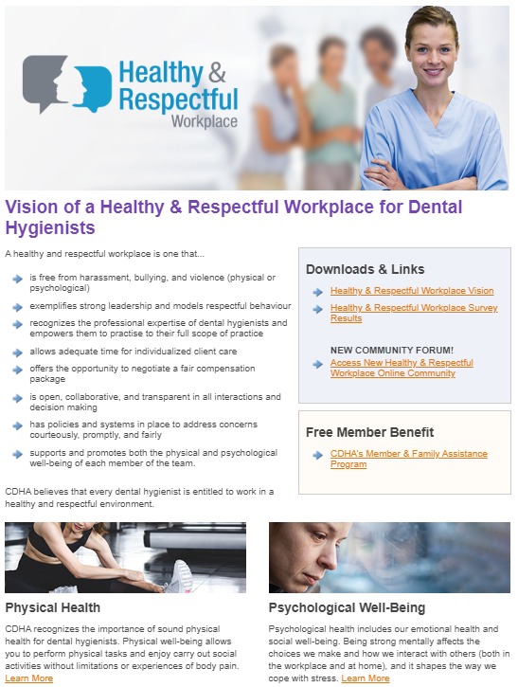
Free with Membership
Healthy & Respectful Workplace
Online community: cdha.ca/community
New website section: cdha.ca/healthyworkplace Physical Health Psychological Well-Being Contracts & Policies Practice Questions
Notes:
You also have FREE access to:
A new healthy and respectful workplace online community – this is where members can share experiences, collaborate, and support each other in order to help address harassment, bullying, abuse, and violence in the workplace. Posts can be made anonymously.
You can also visit the new dedicated healthy and respectful workplace section on the CDHA website and access resources and information to guide you in creating a positive, respectful work environment.

Slide 20
Free with Membership
cdha.ca/healthyworkplace
Notes:
Within the healthy and respectful workplace section, you’ll find a new video series called Conversations to Build Collaborative Workplaces. The videos give guidance and confidence to dental hygienists who are seeking to bridge a divide with a member on their dental team. Unfortunately, work, and life in general, is not all sunshine and roses. This video series can provide you with the tools you need to address challenges in your workplace. As graduating students, CDHA encourages you to view this series.
CDHA also offers further guidance with downloadable resources such as Tips for Conversations to Build Collaborative Workplaces, Tips on How to Address Bullying and Harassment, and Tips to Address Infection Control Concerns.
There’s also an introductory video to get you started and we’ll watch part of it next. Just note that the videos and resources are exclusive to members.

Slide 21
Free with Membership
Notes:
Here’s the sneak preview of the introductory video.
[ TO PRESENTER: here’s the link just in case: https://youtu.be/fy9xCpgsAnM ]

Slide 22
Free with Membership
Counselling Services
Workplace, stress, and family issues
Available 24/7
cdha.ca/Homewood
Notes:
When you transition to an Active/Practising CDHA member, your membership will also include counselling services through a member and family assistance program. Homewood Health is the provider and it’s a relatively new benefit.
The member and family assistance program is a professional and proactive service to support you through a wide range of personal, family, and work-related concerns and is available 24 hours a day, every day of the year. Their website also has great articles and resources, as well as access to the counselling services.

Slide 23
Discounts
GoodLife Fitness
50% off membership
Worldwide Hotel Discounts
Up to 50% discount
Additional insurance program discounts
Home, auto, disability, life, accidental death, clinic business package
cdha.ca/benefits
Notes:
CDHA is constantly striving to enhance the value of your membership. The association is pleased to offer a number of discounted programs including:
GoodLife Fitness – which offers close to 50% off annual memberships
A worldwide inventory of hotels at unbeatable rates
Additional insurance programs including competitive home and auto insurance rates with TD and a variety of personal health insurance plans from Sun Life. Sun Life would be a place to look for that disability insurance was mentioned earlier.
…and more!

Slide 24
QUIZ TIME!
Prize at stake
Notes:
We have another quiz question and a prize to give away for the correct answer. If you think you know the answer, use the chat feature to submit!

Slide 25
Quiz Question
Where is CDHA’s next conference?
ANSWER: Virtual/Online (October 28–30, 2021)
Notes:
Where is CDHA’s next conference?
[ TO PRESENTER – after about 10-15 seconds, check the chat feature to see if you have a winner. ]
Congrats to [ name here ]. They correctly stated the answer! CDHA’s next conference is taking place… Virtually, this October.

Slide 26
2019 Job Market & Employment Survey
cdha.ca/jobsurvey
Executive Summary | Full Report | Report by Province
Notes:
Now, let’s jump into the topic of jobs.
Every other year, CDHA surveys members in order to obtain a national perspective of employment and compensation trends and workplace environment.
Once the data is compiled, CDHA members receive complimentary access to the executive summary, full report and report by province. Keep in mind this information can be helpful when negotiating a job offer.
Let’s take a look at some of the highlights from the 2019 executive summary.

Slide 27
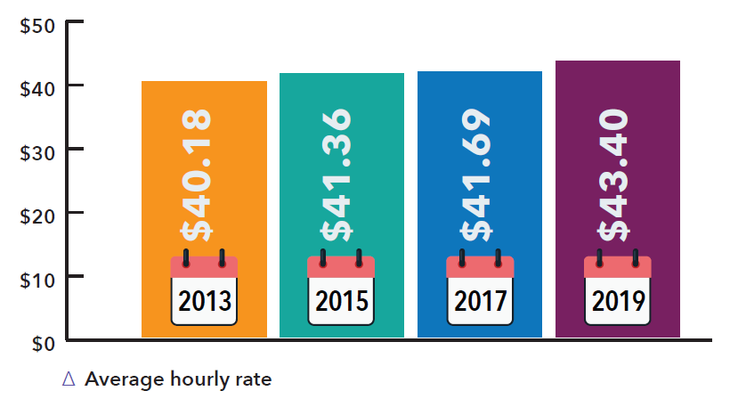
2019 Job Market & Employment Survey
Average hourly rate – first job setting
Notes:
The reported average hourly rate for a first practice setting in 2019 is $43.40, which continues the trend of incremental increases seen in previous years ($41.69 in 2017, $41.36 in 2015, $40.18 in 2013).
This hourly pay rate has increased by 4.1% since 2017. And, consistent with previous years, Alberta has the highest hourly rate at $55.26; New Brunswick has the lowest hourly rate at $32.99.
Here’s the provincial/territory breakdown:
Alberta - $55.26
British Columbia - $46.10
Manitoba - $42.84
New Brunswick - $32.99
Newfoundland & Labrador - $40.23
Nova Scotia - $35.12
Ontario - $38.92
Prince Edward Island - $35.34
Quebec - $36.47
Saskatchewan - $43.38
The North - $47.80

Slide 28
2019 Job Market & Employment Survey
Dental hygiene education & mean annual income
(working more than 30 hours/week)
Notes:
In terms of Dental Hygiene Education and Mean Annual Income (working more than 30 hours/week):
Stating the highest level of dental hygiene education completed, 73% of respondents have a dental hygiene diploma credential and earn $70,938.43, on average.
The second most common academic credential is a 4-year bachelor’s degree in a field other than dental hygiene (10%), with average annual earnings of $75,147.74.
The third most common academic credential is a 4-year bachelor’s degree in dental hygiene (5%), with average annual earnings of $77,910.70.
Respondents with a master’s degree (2%) have the highest average annual income ($92,142.73).
Having a degree will open other doors for you during your career.

Slide 29
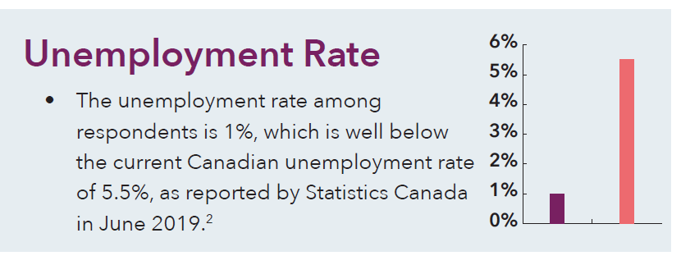
2019 Job Market & Employment Survey
Notes:
The unemployment rate among respondents is 1%, which is well below the current Canadian unemployment rate of 5.5%, as reported by Statistics Canada in June 2019.

Slide 30
2019 Job Market & Employment Survey
Hours of work / week: satisfaction has increased
2013 – 65%
2015 – 65%
2017 – 71%
2019 – 73%
Notes:
Satisfaction with the number of hours of work per week is increasing. In 2019, 73% of respondents say they work as many hours as they would like (71% in 2017, 65% in both 2015 and 2013).
Respondents from Saskatchewan and New Brunswick report higher levels of satisfaction with the number of hours worked (average rating of 8.5 out of 10), which is consistent with the findings of the 2017 survey.

Slide 31
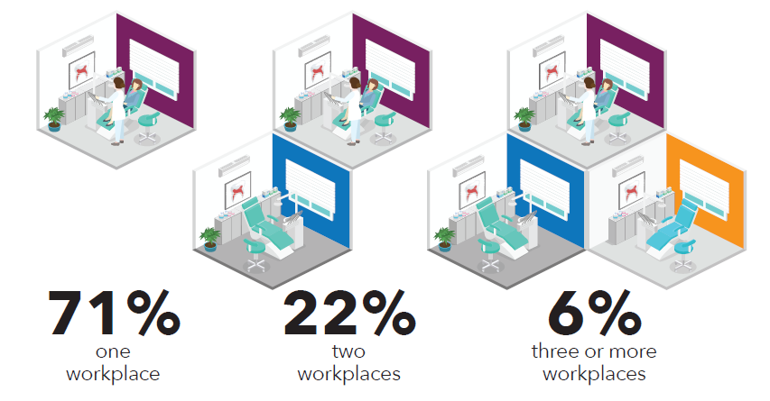
2019 Job Market & Employment Survey
Workplace & Environment – setting
Notes:
Now let’s look at Workplace and Environment.
91% of respondents report working in a private practice as their first practice setting, followed by public health (3%) and education (3%).
71% of respondents work for a single employer which is pretty consistent with previous survey results.

Slide 32
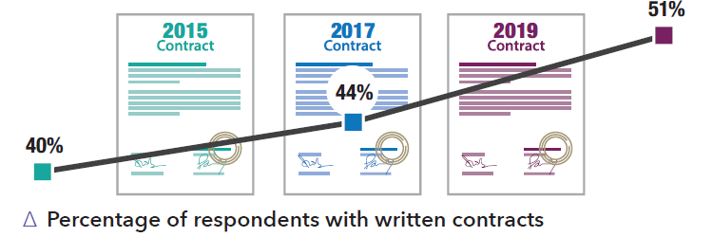
2019 Job Market & Employment Survey
Workplace & Environment – contracts
Notes:
The number of respondents reporting that they have written contracts has been trending up, from 40% in 2015 and 44% in 2017 to 51% in 2019.
An employment contract outlines duties and responsibilities on both the employer and the employee’s part. We’ll talk about more on this in a bit.

Slide 33
2019 Job Market & Employment Survey
Negotiating a Compensation Package
Notes:
To help guide you in negotiating a compensation package, CDHA has a resource that is perfect for new grads.
When starting at a new place of employment, you want to begin on the best possible terms… for you!
Find this resource under “Contracts & Policies” in the healthy and respectful workplace area of the website.

Slide 34
Free Webinar
cdha.ca/jobsurvey
Notes:
To get a better understanding of the survey highlights focusing on trends in compensation segmented by geography and other criteria, we encourage you to a watch a free webinar.

Slide 35
CDHA’s Job Board
cdha.ca/jobs
Notes:
After you’ve graduated and satisfied your province's regulation requirements, your focus will naturally turn to finding a job as a dental hygienist. Or perhaps your search has already started!
CDHA’s job board is a great place for employers and prospective employees to connect and it’s one of the most active areas of CDHA’s website.
To view the current opportunities, visit our website. You must be logged in to view the information.

Slide 36
CDHA’s Job Board: Weekly Alerts
Notes:
You can also sign up for CDHA job board alerts and have job postings delivered to your inbox each week.

Slide 37
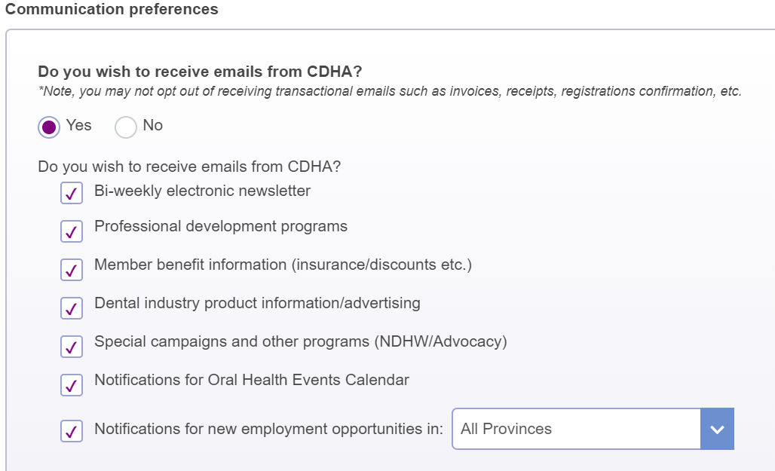
CDHA’s Job Board – Weekly Alerts
Notes:
To activate the weekly alert, edit the communication preferences in your online profile and check the "Notifications for new employment opportunities" box. You can specify a specific province/territory or select “All Provinces.”

Slide 38
Applying for a Job
Résumé
List skills, experience, abilities
Format, editing, and design
Cover Letter
First impression
Customize
Research employer
Format, editing, and design
cdha.ca/careers
Notes:
When you are ready to apply for a job, you will need to provide a résumé and cover letter.
This slide quickly lists what elements should be part of your résumé and cover letter along with other items to keep in mind.
More detailed information can be found on the CDHA website.

Slide 39
The Interview
Preparation
Research
Practice
Presentation
Dress professionally, conservatively
Job fit
Position / firm right fit?
Ask questions
cdha.ca/careers
Notes:
After you’ve landed an interview with your stellar résumé and cover letter, use the interview as an opportunity to show the employer your interest in the position and, in turn, the energy and expertise you will bring to the job.
Getting to this stage shows that the employer has deemed you as qualified for consideration, and the interview is your chance to show that you will put that qualification to good use.

Slide 40
The Interview
Communication and etiquette
Good verbal and non-verbal communication skills
Listen carefully, answer thoughtfully
Arrive early
Concluding the interview
Thank interviewer; restate interest/qualifications
Next steps, thank you note
Working interviews
Notes:
While at the interview and when the interview concludes, there are a number of items to do or keep in mind and a short list is included here. More items are on the CDHA website.
Working interviews, noted here, are sometimes used for dental hygiene positions. If your interview falls into this category, don't be more stressed because of it; think of it as a first day on the job with no obligations. But keep in mind that the prospective employer should pay you. If they decline, take this as a sign to move on.

Slide 41
Contracts
Self-employed vs. employee status
Contract wording – determines if Revenue Canada decides you are employee vs. independent contractor
Contract OF service = employer-employee
Contract FOR services = self-employment
Sample contracts
cdha.ca/careers
Notes:
When you decide to commit to a position, ensure that there is an appropriate written contract in place. Having a written employment contract allows both you and your employer to have a clear understanding of the expectations that you have of each other. Understanding the difference between self-employment and employee status is extremely important when setting up your relationship with your employer and in the creation of your contract. Just because an employer wants to hire a dental hygienist as an independent contractor, does not mean that the job meets the criteria of being deemed an independent contractor by CRA. If you are being offered an independent contractor position, please make sure you review CDHA’s Self-Employed vs. Employee Status page under the Career section. CDHA also has the resource Negotiating a Service Agreement as an independent contractor in the contracts and policies section of healthy and respectful workplace.
When you receive a contract, your potential employer has to give you adequate time to fully review it. It is also recommended that you have a legal professional review the contract.
There are advantages and disadvantages of being self-employed. Visit the CDHA website for more details along with reviewing sample employment and self-employment contracts.

Slide 42
Social Media Webinar
cdha.ca/webinars
Notes:
Let’s turn our attention to social media for a moment. Most, if not all of you, use social media. As you enter the profession, you may decide to utilize the power of social media to become an influential voice of your new profession.
CDHA invites you to watch a recent webinar about social media engagement. This session examines the far-reaching impact of social media and how we can harness it. By examining the rules of engagement, you will learn the dos and don’ts of social media for health care professionals, including code of conduct, privacy considerations, and professional responsibilities. The webinar will also feature specific examples, tips, and tools, and will also highlight best practices for success.

Slide 43
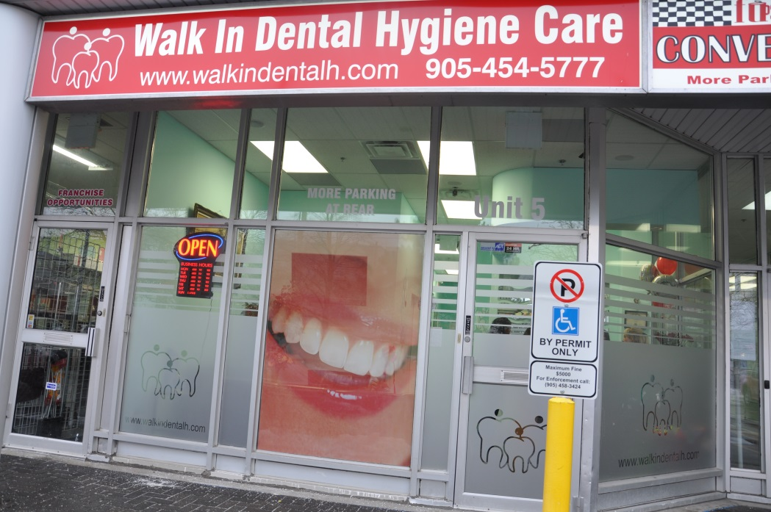
Independent Practice
Own/run business
Work independently or lead team
Offer clients a wider range of choices
Improve access to dental hygiene care
Independent Practice Network (IPN): cdha.ca/IPN
Notes:
Now let’s briefly talk about independent practising dental hygienists. How many here have thought about opening their own dental hygiene business? Can you show your hands if you are interested or use the chat feature?
RDH’s may provide oral healthcare in settings other than a dental office. They may choose to have their own office or operate a mobile practice where they travel to their client's place of residence. Essentially, dental hygienists in independent practice run their own business. They have the freedom to make their own decisions and offer clients a wider range of choices.
They play an important role in improving access to dental hygiene care. And support for independent practitioners is a high priority for CDHA.
A few years ago, CDHA launched the Independent Practice Network which is designed to meet the specific needs of this growing community. A unique set of membership benefits belongs to this group. An IPN member has access to business courses to help guide them in opening and building their business, access to an online community to provide support, or get support from other IDH’s. as well as a marketplace online community where IDH’s can post equipment they have for sale.

Slide 44
Independent Practice Network:
By the Numbers
PROVINCE | # | PROVINCE | #
Alberta | 179 | Nova Scotia | 14
British Columbia | 143 | Ontario | 737
Manitoba | 10 | Québec | 22
Newfoundland & Labrador | 21 | Saskatchewan | 9
New Brunswick | 19 | The North and PEI* | 2
*The North and PEI do not currently allow dental hygienists to work as independent practitioners.
Notes:
There are more than 1,100 dental hygienists registered in CDHA’s Independent Practice Network and here are the numbers by province. Note that The North and PEI do not currently allow dental hygienists to work as independent practitioners.
However, in exciting news… On September 24, 2020, Quebec’s National Assembly unanimously passed a law allowing dental hygienists to practise independently, without supervision from a dentist. This is a historic moment for the dental hygiene profession in Quebec and cause for celebration across Canada as we move one step closer to accessible oral health care for all. For the first time, Quebec residents can now be treated directly by dental hygienists in any setting.

Slide 45
CDHA Membership
Make sure your Student membership is current!
cdha.ca/join
cdha.ca/renew
1-800-267-5235
Notes:
So that is what CDHA membership can do for you in a nutshell. Remember, only current Student members will be eligible for FREE Graduated membership upon successful completion of the board exam.
If you haven’t joined or renewed your Student membership with CDHA, you still have time and it’s easy! Visit cdha.ca/join and select the Student Membership icon. Or renew at cdha.ca/renew. Giving CDHA a call is another option.

Slide 46
Contact CDHA
cdha.ca
info@cdha.ca
1-800-267-5235
Notes:
CDHA staff members are available to assist you with a variety of dental hygiene or membership inquiries or with any other related questions you may have.
Contact them:
By visiting the CDHA website
By email
Or by telephone

Slide 47
Connect with CDHA
.com/theCDHA
Request to join today!
.com/theCDHA
.com/groups/CDHAdentalhygienists
.com/theCDHA
Notes:
Make sure you have the opportunity to connect and share with CDHA and each other on various online and social media platforms.
Please note that at the start of the COVID-19 pandemic, CDHA’s Facebook page was shut down for an unknown reason and Facebook still hasn’t reinstated it. CDHA created an interim group called “CDHA & Dental Hygiene News” – you can request to join the group today!

Slide 48
Notes:
Congratulations on your choice of an exciting career in dental hygiene! Join the CDHA community and let your voice be heard.

Slide 49
QUIZ TIME!
Prize at stake
Notes:
It’s time for the final quiz question and last prize giveaway! If you think you know the answer, please use the chat feature.

Slide 50
Quiz Question
What CDHA membership benefit most excites you?
CDHA Perks: Perkopolis / ESM
Professional Development
Counselling
Liability Insurance
Publications
Career Site / Jobs
FREE Webinars
GoodLife Fitness
… and more!
Notes:
Final quiz question: What membership benefit most excites you?
Congrats to [ name here ]. They correctly stated a current membership benefit!
And the answer is that… There are a number of membership benefits available to you that should excite you! Some are listed here and there’s more on CDHA’s website.

Slide 51
Questions?
Notes:
Thank you for your time. Do you have any questions?

